Slide 1
Recovering From A Natural Disaster
Sam Atkinson
Director of Special Projects and Audit Response
MS Office of the State Auditor
May, 2018

Slide 2
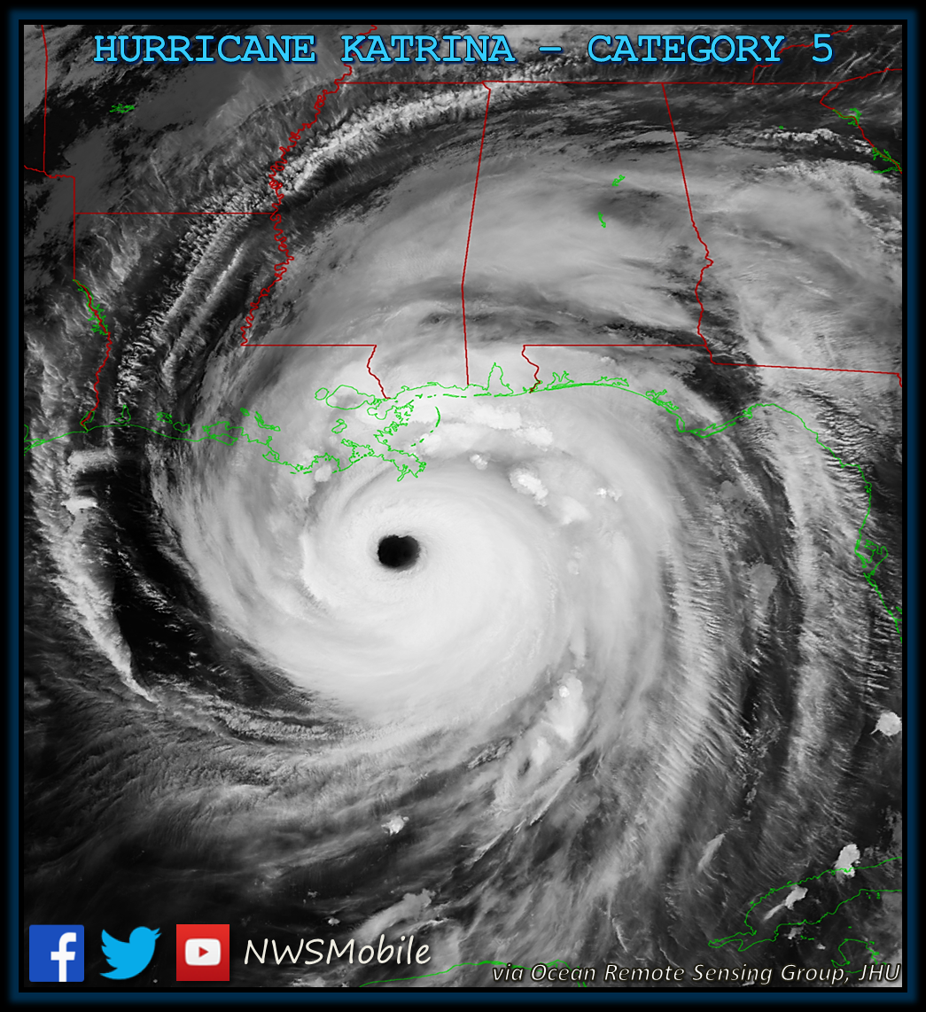
Katrina: August 29, 2005
At 6:10 AM, Katrina made its third landfall as a strong Category 3 hurricane at Bay St. Louis, MS, with sustained winds of more than 125 mph (205 km/h), and gusts over 140 mph.

Slide 3
Katrina: August 29, 2005
Storm Surge
28-37 ft in Bay St. Louis and Waveland, MS
20+ ft. in Biloxi and Pascagoula more than 55 miles away
Destruction and Tornadoes across Mississippi
Survived Camille, Destroyed by Katrina
Buildings, Homes, Roads, Underground Infrastructure—All Destroyed
Notes:
28+ ft. sustained storm surge in Bay St. Louis, Mississippi, and 20+ ft in Biloxi and Pascagoula more than 55 miles away.
In Bay St. Louis, areas more than a mile inland that didn’t flood during Camille had houses entirely under water from the storm surge
Destruction from Katrina and spinoff tornadoes affected most of Mississippi All 82 counties declared disaster area, 47 of those counties declared MAJOR Disaster Areas
Much of the historic Mississippi Gulf Coast that had survived Hurricane Camille in 1969 was destroyed by Katrina.
Banks, stores, homes, government buildings, roads and underground infrastructure were all destroyed.

Slide 4
Katrina: Auditor’s Role
Two days to prepare
Worked with Emergency Management
Prepared Information for Government Officials
Investigators Assigned to Work with Other First Responders
Placed Audit Employees at State EOC
Made Pre-Storm Contact with All OSA Employees
Notes:
From August 27 until two days later when the storm hit, OSA was one of the agencies called upon to help prepare:
Working with Emergency Management—
Property Logistics
Provide contact information about local government leaders
Preparing information for local governments related to contracting and procurements
Assigned OSA Investigators to work with first responders to secure public facilities and other assistance as needed
Placing employees at the State Emergency Operations Center (EOC)
Contacting all OSA employees that might be in the affected areas

Slide 5
Katrina: The Aftermath
Internal Operations the Day After
Employee Contact
PAYDAY-NO ELECTRICITY
Deploy Staff
External Work Immediately After
Devastating Losses, Public and Private (affecting government services)
PAYDAY
Notes:
Internally:
Determine safety of OSA employees (cell and landlines down), but CSPIRE texting worked…
Get Paychecks out (No power, even in Jackson, No direct deposits available from state or to many banks)
Deploy staff as requested by Emergency Management
Externally OSA knew that governments would struggle:
The total devastation of the Gulf Coast and destruction of many government buildings inland, including electronic and paper records
The loss of infrastructure (roads, bridges, water, sewer, electricity, cell towers, landmarks, etc.)
The loss of gas stations, banks, stores
Government employees and first responders, many of whom had lost their homes and cars, and without cash had no access to money
Payday with no direct deposit!

Slide 6
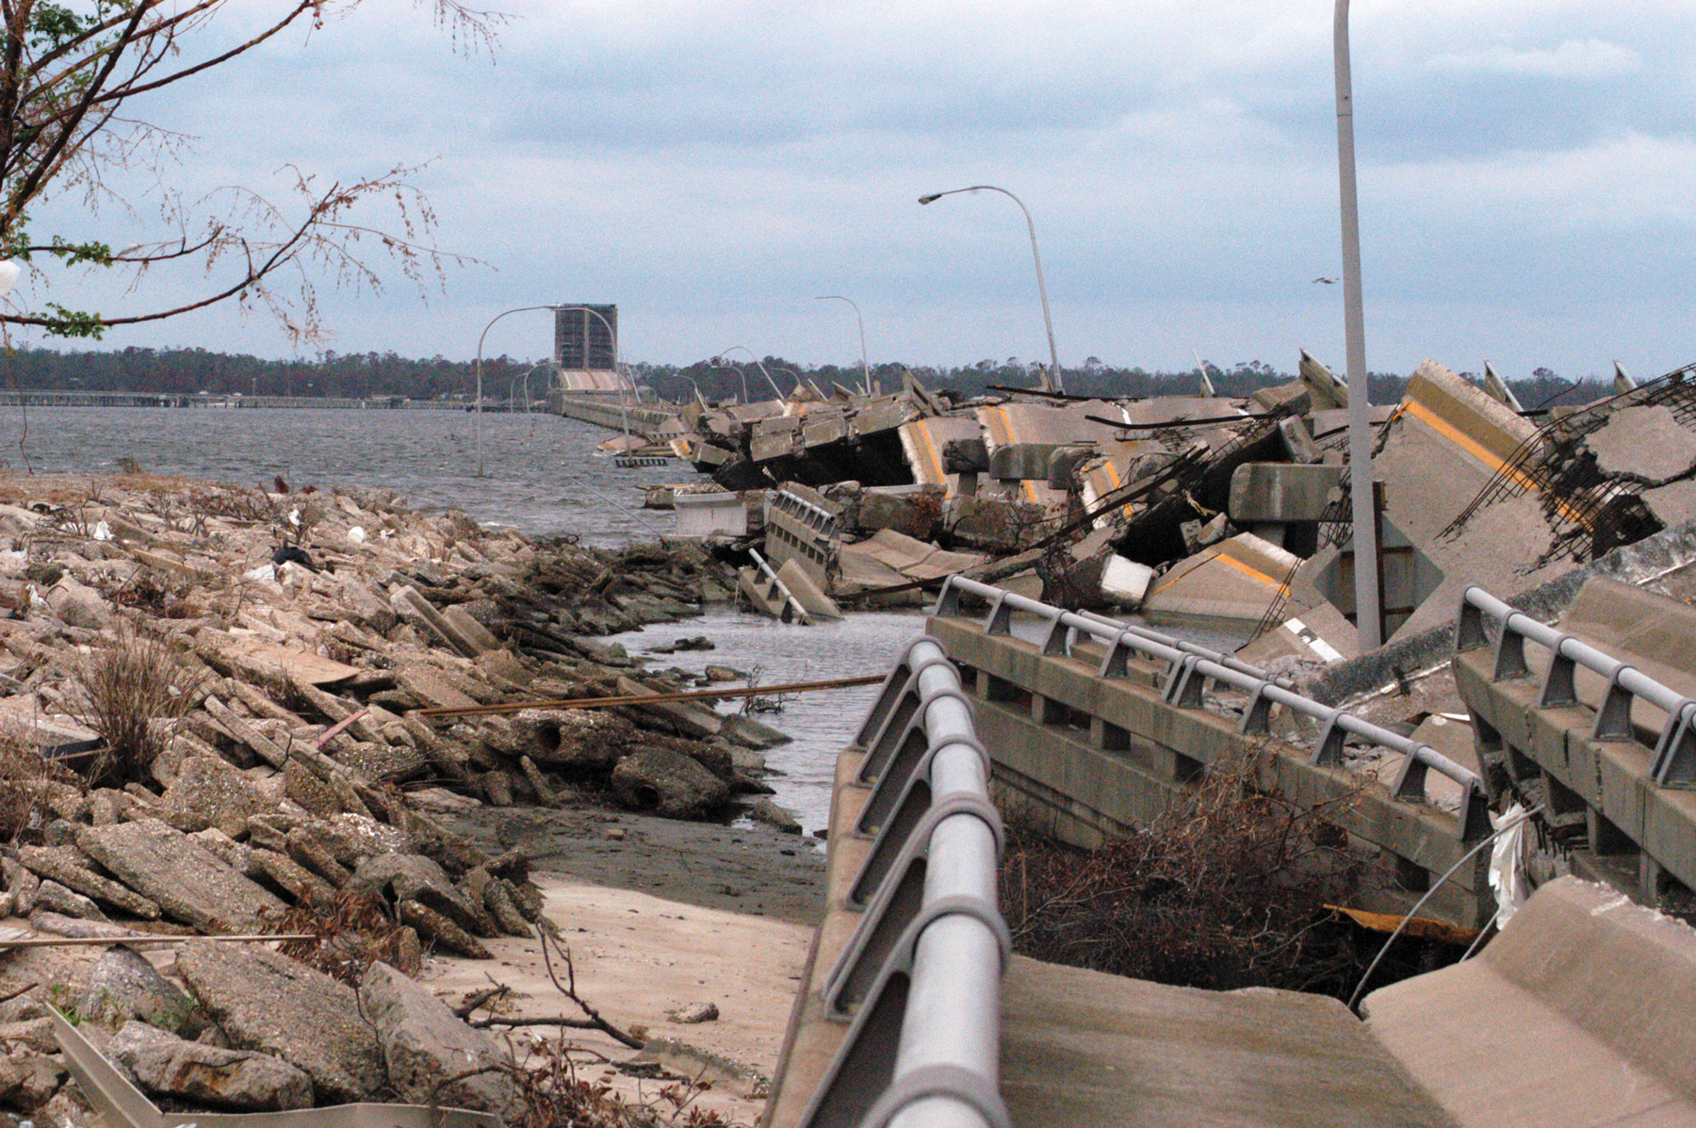
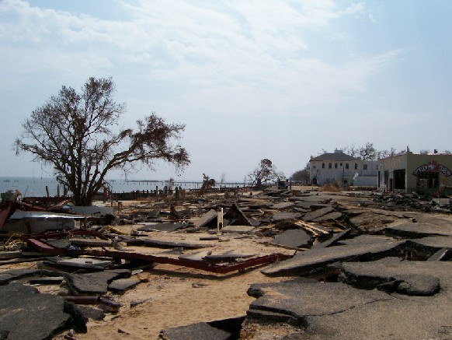
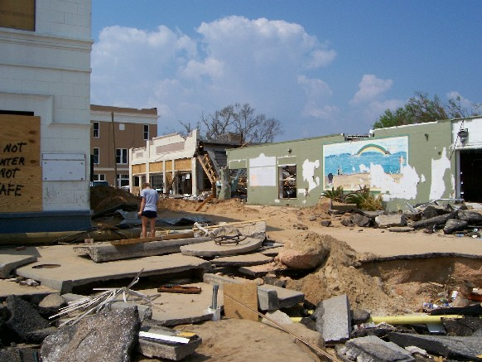
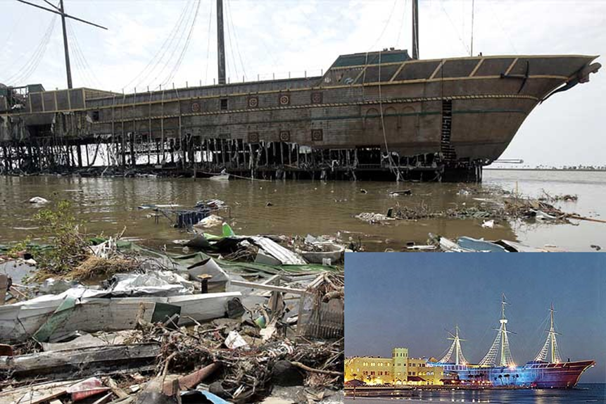
Before and After
Notes:
Bay St Louis Bridge
Highway 90 roads
Downtown Bay St. Louis
Treasure Bay Casino

Slide 7
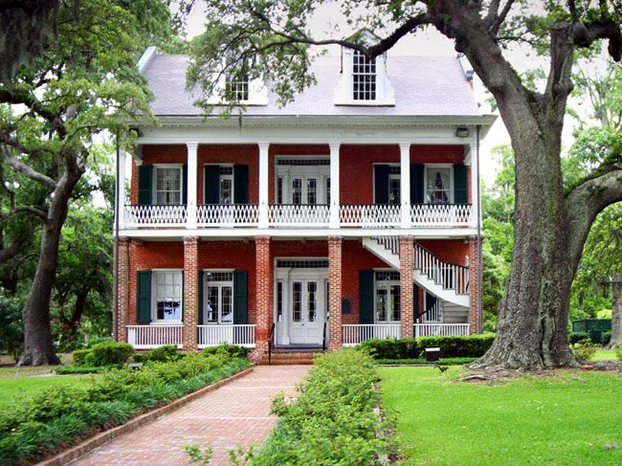
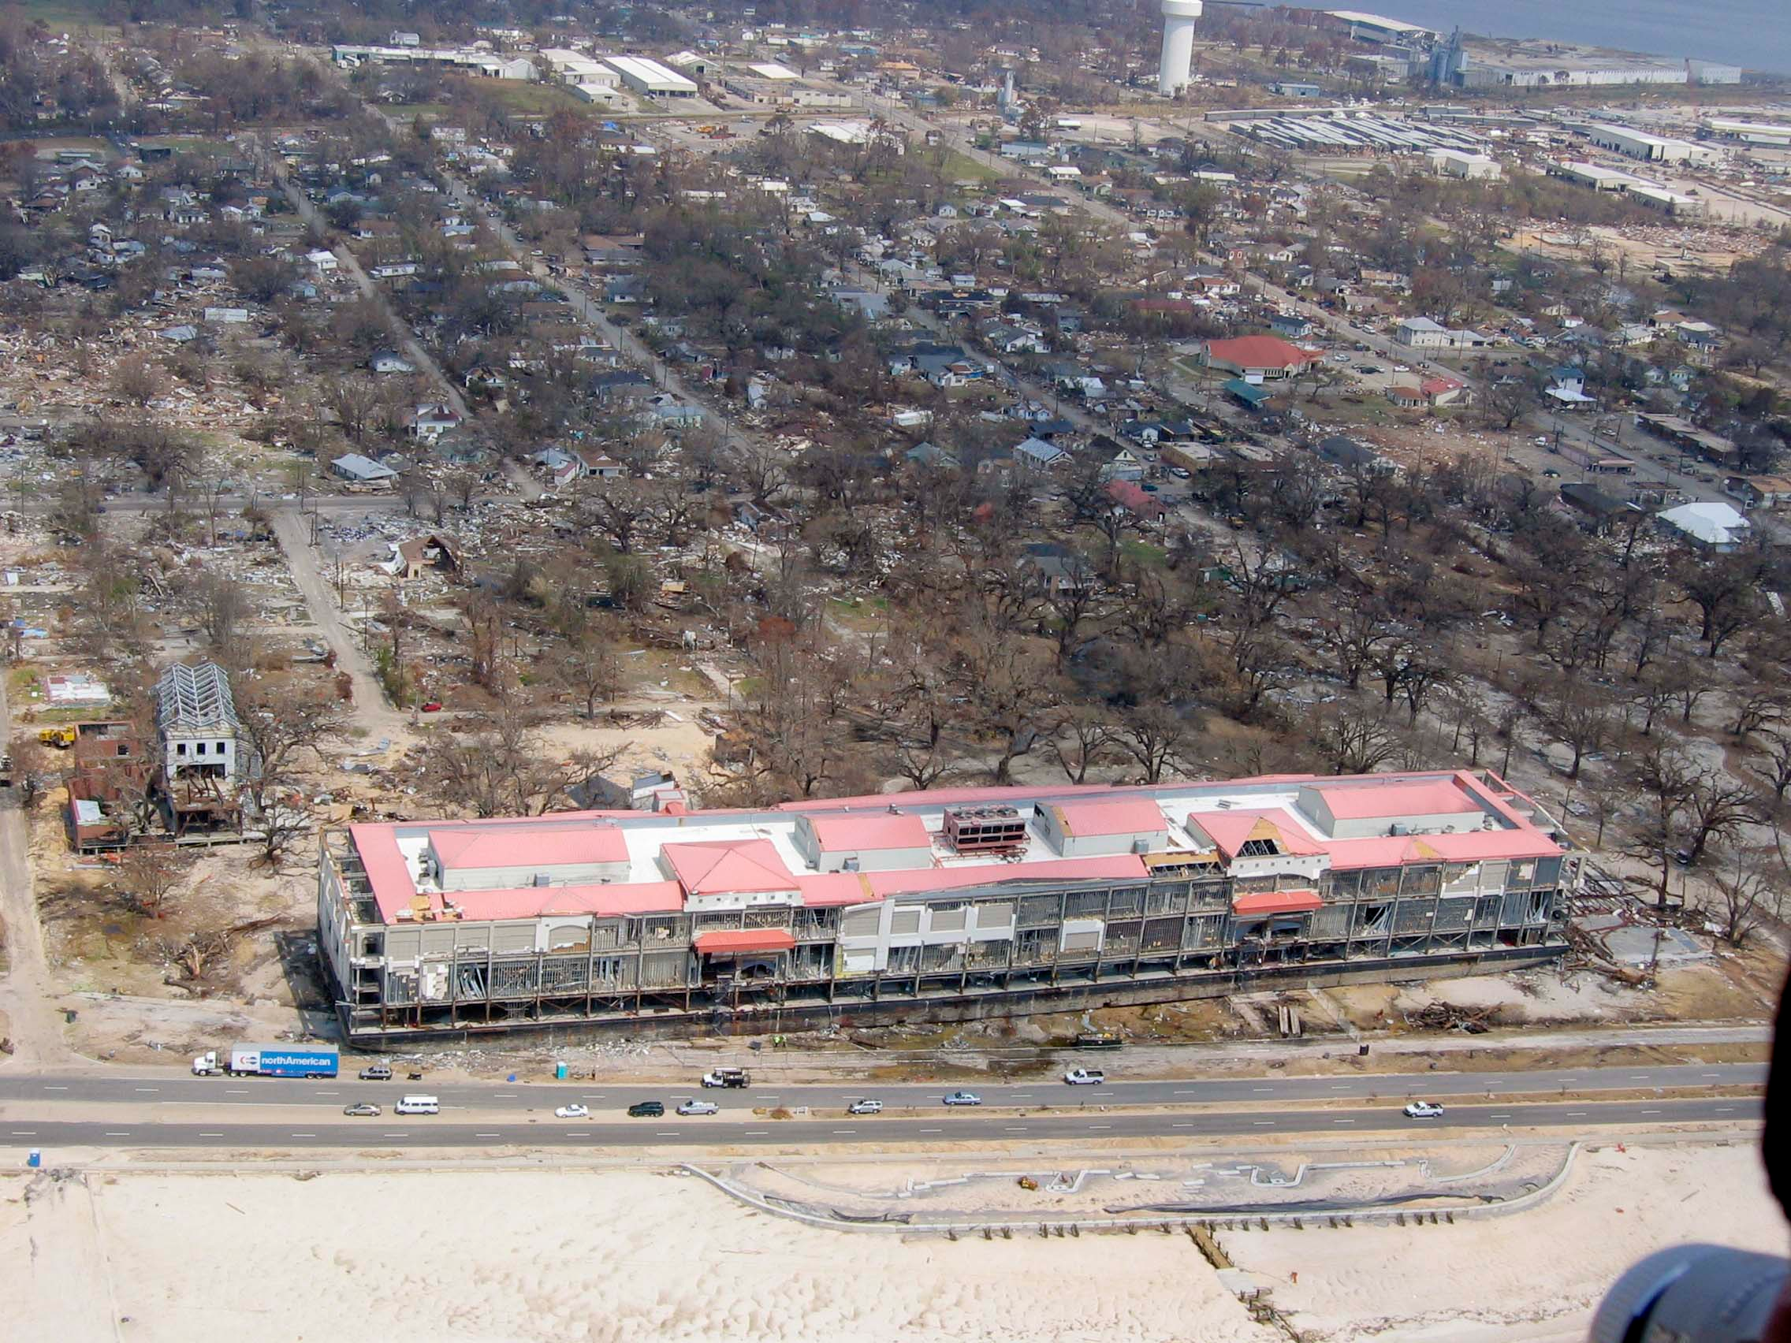
Before and After
Notes:
Built in 1856, it withstood Camille with almost no damage.
Unfortunately, Katrina’s storm surge carried an entire casino on top of it…

Slide 8
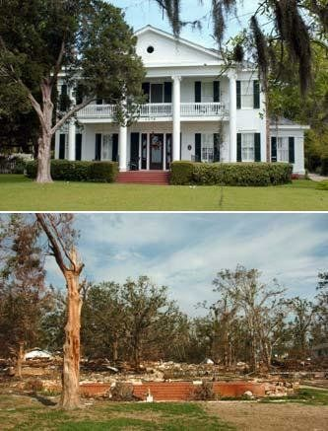
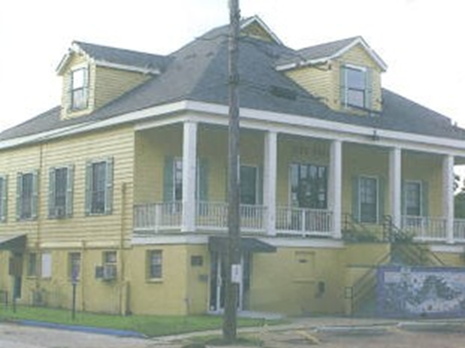
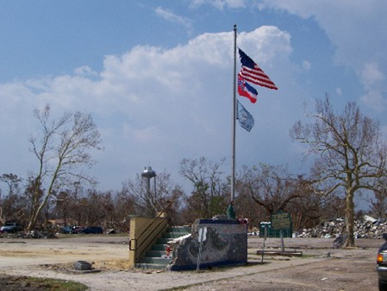
Before and After

Slide 9
Katrina: The Aftermath
Investigators & Financial Auditors
Technical Assistance & Performance Audit
Work with Federal Officials
Review Purchasing/Contracting Laws
Provide Information & Assistance
Notes:
OSA continued to reassign Investigators (as sworn law enforcement)
Financial Auditors geared up to review local government work (first “real time auditing”) Reviewed contracts, regulations, and expenditure reimbursement reports—turned over suspicious activity to Investigations Task Force
OSA pulled in all available Technical Assistance and Performance Audit staff to:
Work with federal officials regarding recovery funds
Research potentially conflicting federal State laws that might prevent local governments from accessing or using disaster recovery funds
Make recommendations for State purchasing law changes to negate conflicts
Assist local government leaders by answering questions
Prepare information that could be distributed to local officials quickly

Slide 10
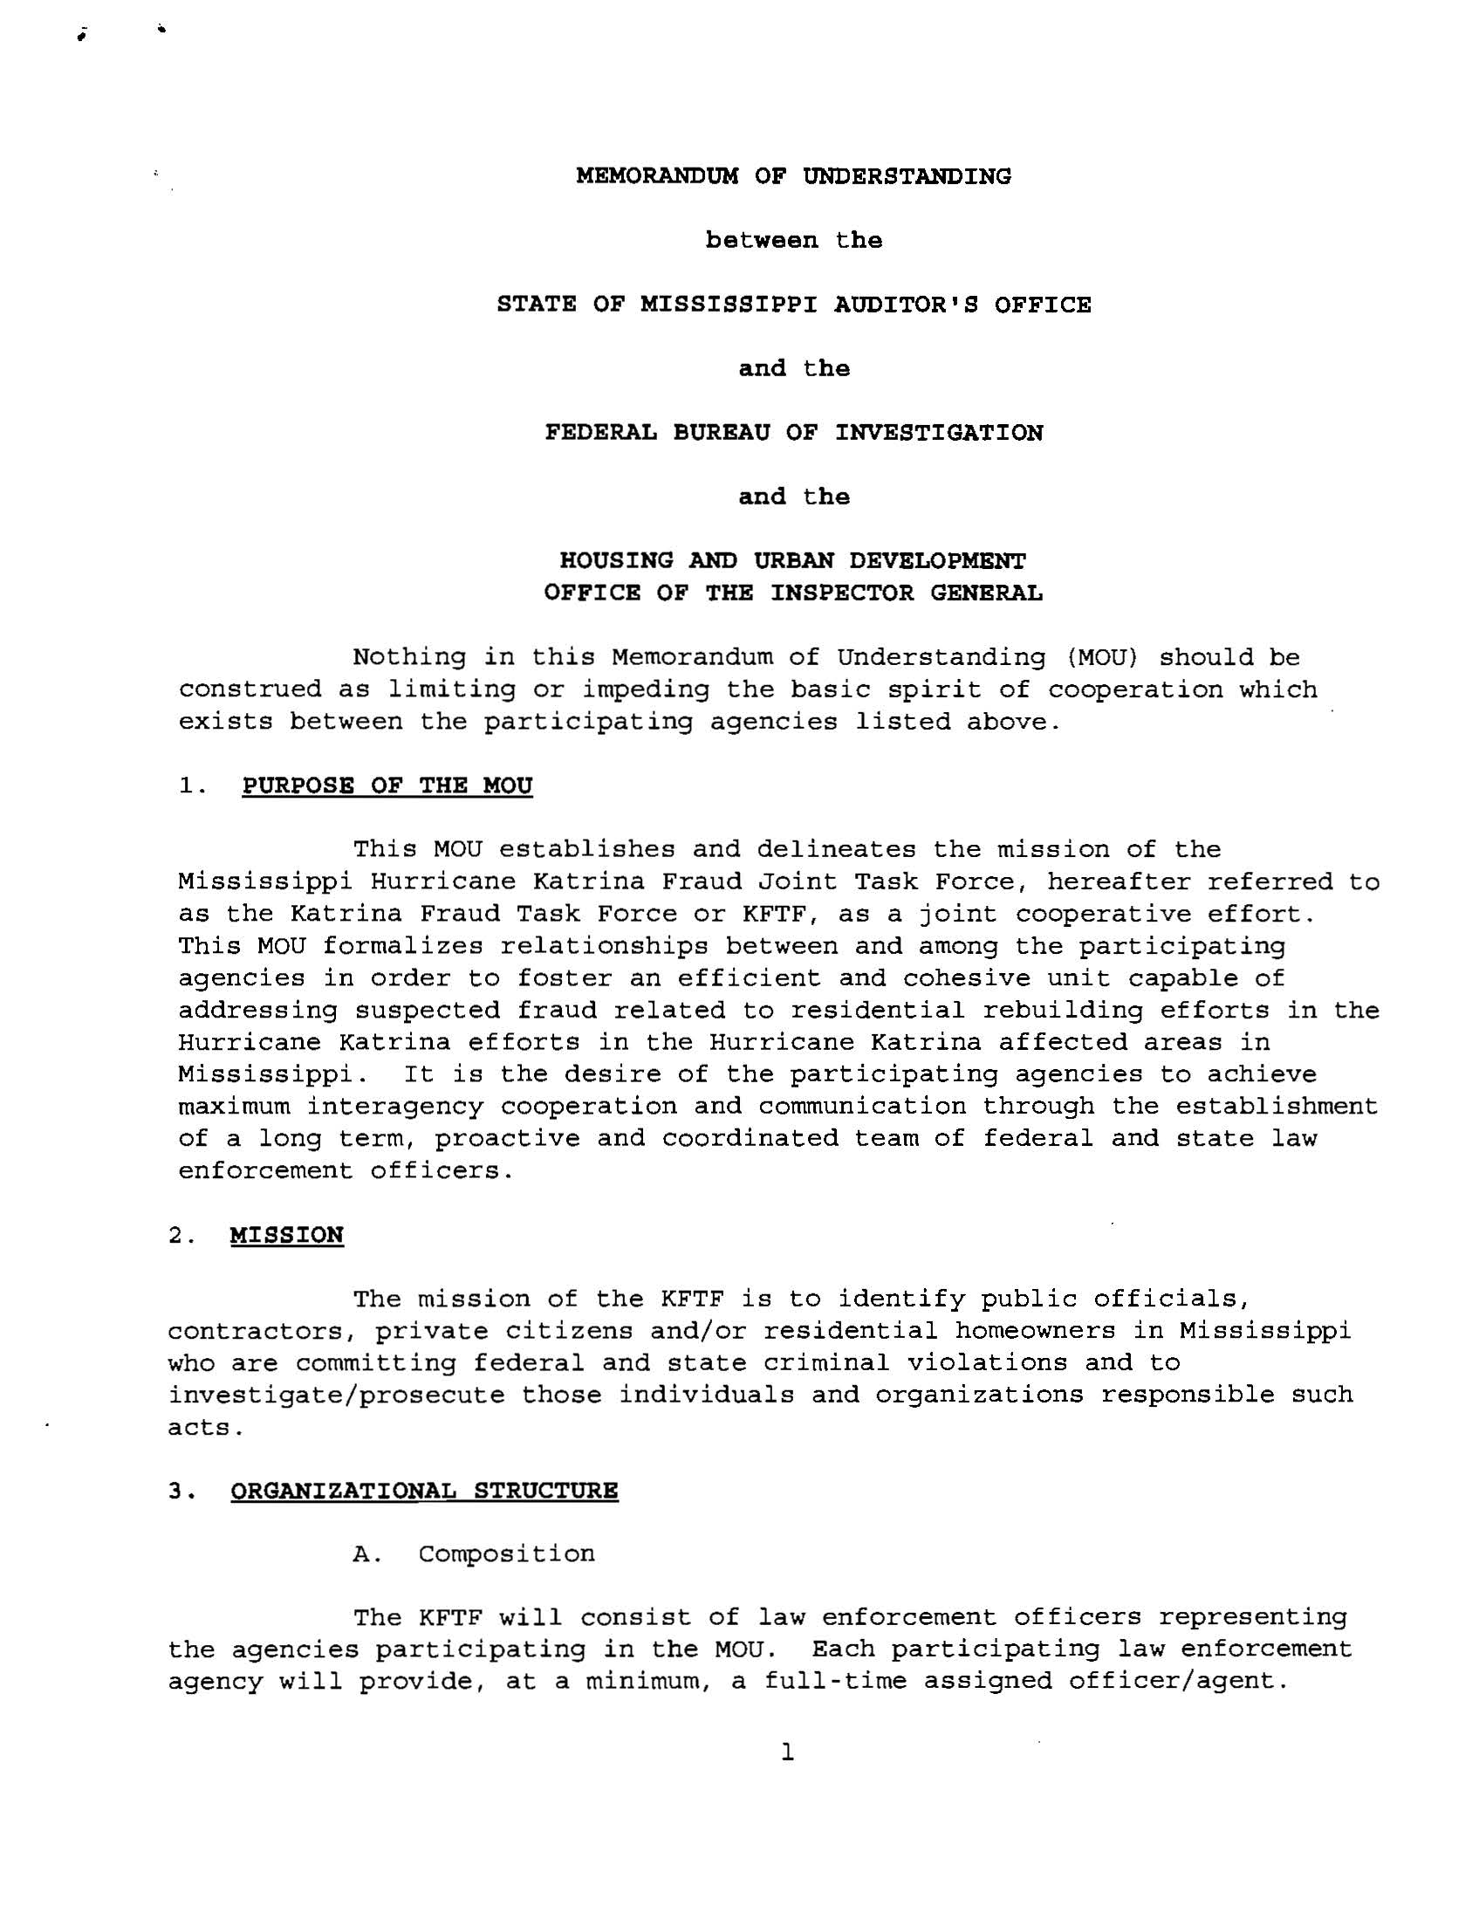
Katrina: Preventing Fraud
Fraud Hotline
Report Fraud Advertisements
Katrina Fraud Unit
Federal/State Team with FBI, USAG, Homeland Security, FEMA, and OIG
Estimated < 0.5% Undetected Fraud in MS
Notes:
Opened a Katrina Fraud Hotline
Created Fraud Reporting flyers and advertisements
Started and maintained the Gulf Coast Katrina Fraud Unit, which worked in conjunction with federal officials and task forces (FBI, USAG, Homeland Security, FEMA, and OIG)
Resulted in less than 1% of fraud

Slide 11
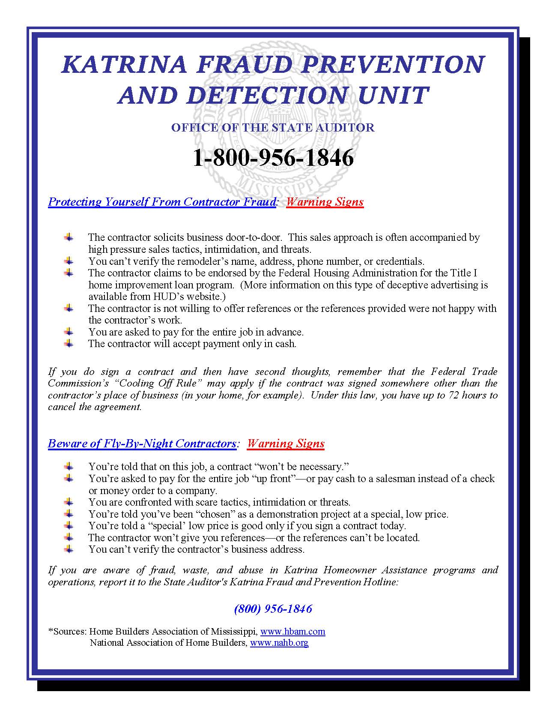
Fraud Prevention
For Homeowners and Businesses
Provided to local government officials for distribution
Provided to radios, newspapers, and TV stations to raise awareness

Slide 12
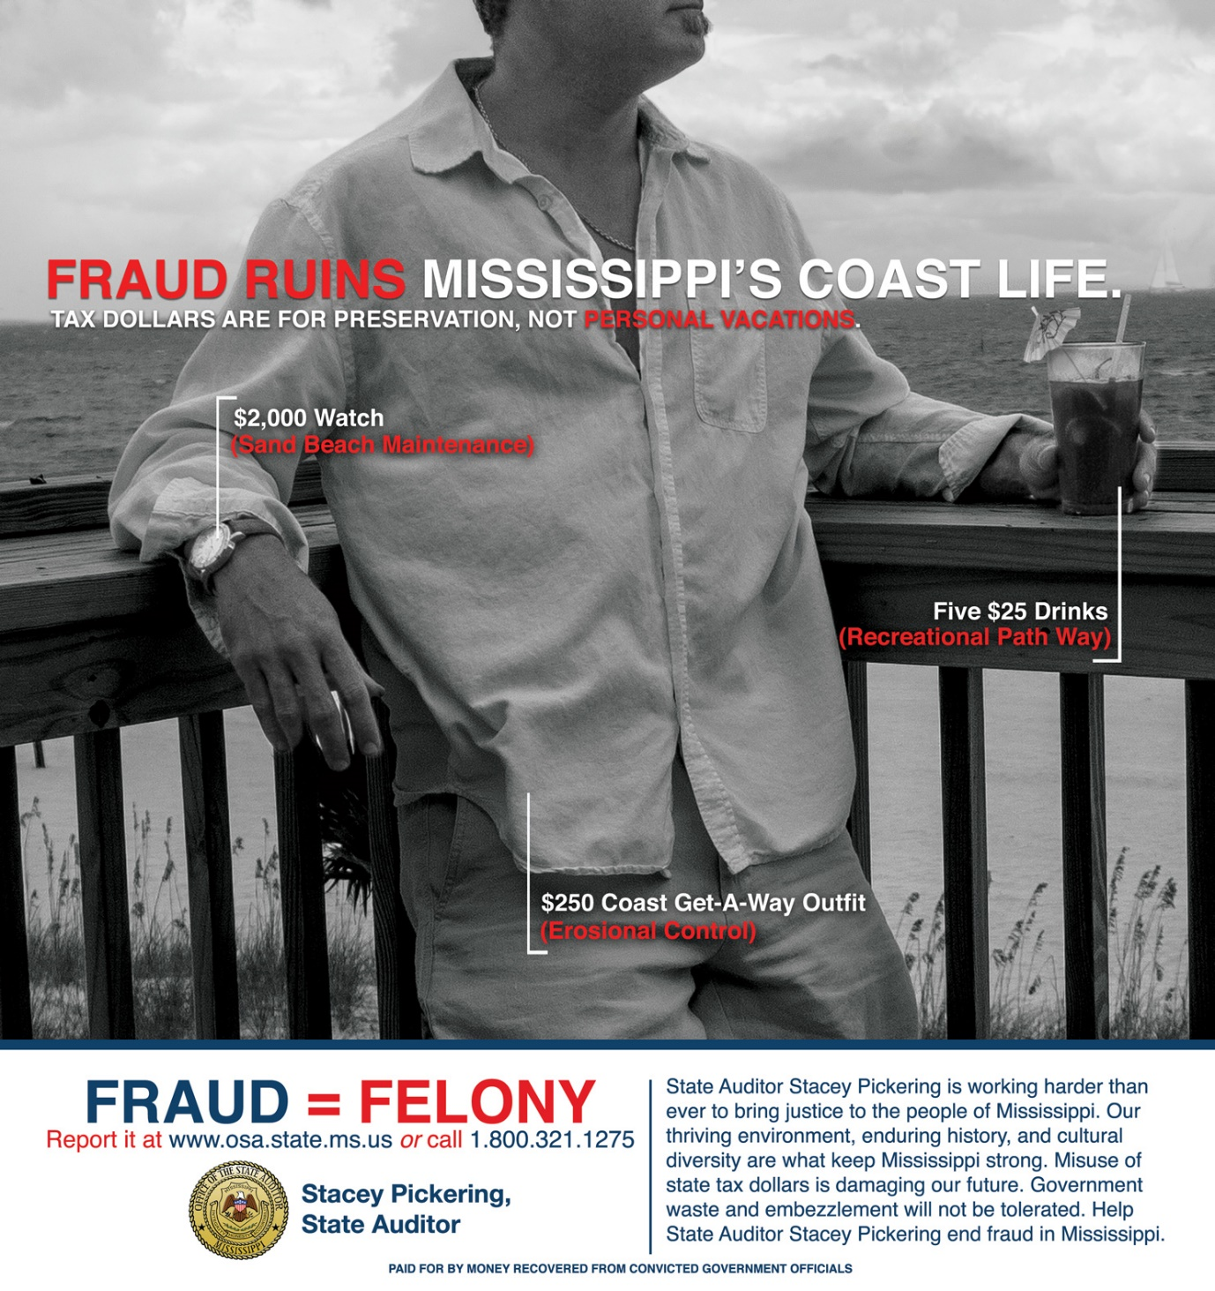
Long Term Fraud Prevention

Slide 13
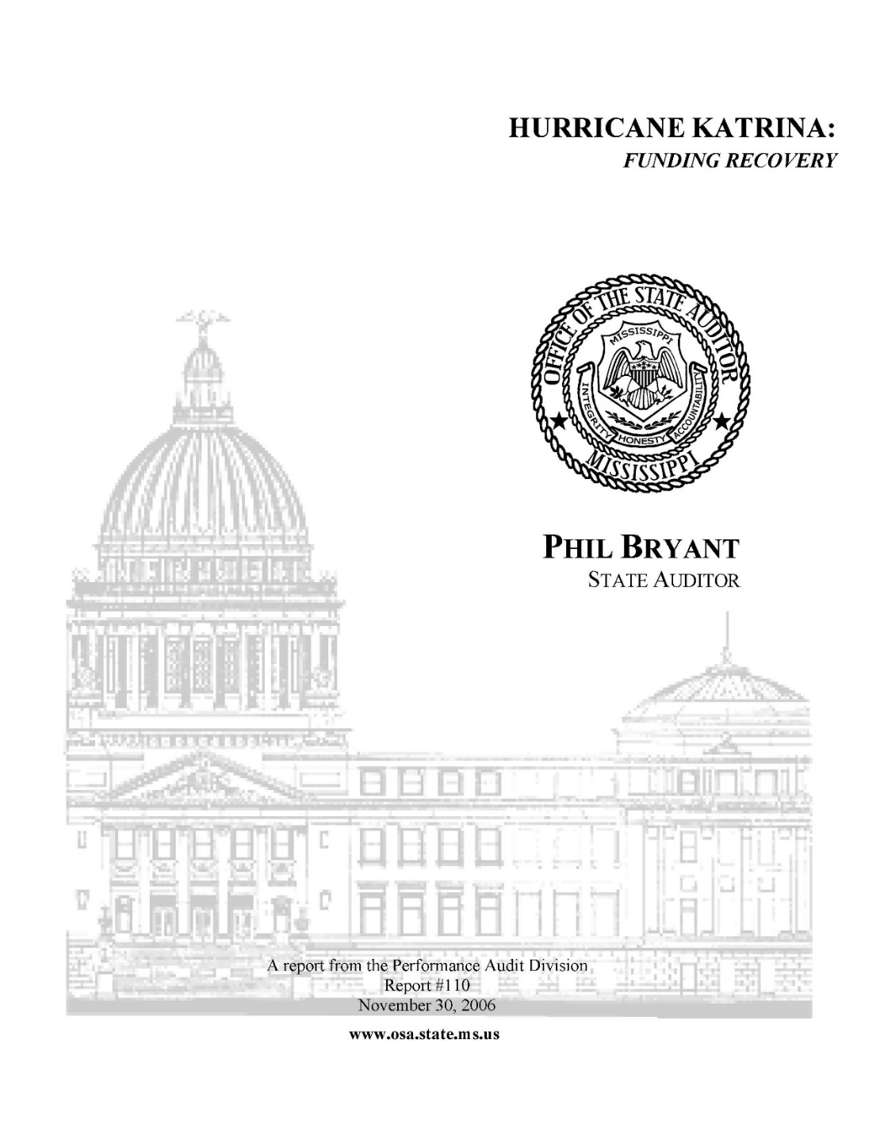
Katrina: The Later Years
Tracked, Audited, and Reported Recovery Funds
Monitored and Audited Oversight of Contracts
OSA Property Division
Notes:
Tracked and reported various types of recovery funds received by local governments
Used in reports to the Governor and the Legislature regarding accurate financial shortfalls after insurance and disaster recovery payments
Used many years later to defend the state against accusations of funding shortfalls in the education system by showing accurate reimbursements and additional funds from insurance, the federal government, and the state government
Monitored and audited oversight of debris removal contracts, housing contracts paid by State CDBG funds, and other payments from the state to local governments
The OSA Property Division was integral not just at the Emergency Management Headquarters identifying and coordinating publicly owned property logistics, but,
For many years afterwards, helping to determine what property losses were actually related to Katrina, and which were improperly being attributed to the hurricane.

Slide 14
Katrina: 2012
Federal Government Demands Repayment
$1.8 billion/7,500 claims sampled
More than $25 million determined to have been misspent
Multi Agency Team
OSA work resulted in reduction to below $200,000
Notes:
7 Years later, the US Treasury sent a $20+ million demand for Katrina funds it believed were not properly spent.
The OSA Performance Audit Division became part of a special multi-agency team to audit, review, and reconcile 7,500+ Hurricane Katrina Public Assistance and state warrant transaction details ($1.8B) for FY 2007 through FY 2011 against the US Treasury PMS Smartlink ACH reports.
They reviewed the MEMA Public Assistance grant document management system and the MEMA audit monitoring program of public assistance subgrantees
The team successfully reduced the amount owed to less than $200,000.

Slide 15
Thank You!
Sam Atkinson
P.O. Box 956
Jackson, MS 39205
Ph: 601-576-2800
800-321-1275 (statewide)
Web: www.osa.ms.gov

