Slide 1
Public Corruption
In Mississippi
September 29, 2015

Slide 2
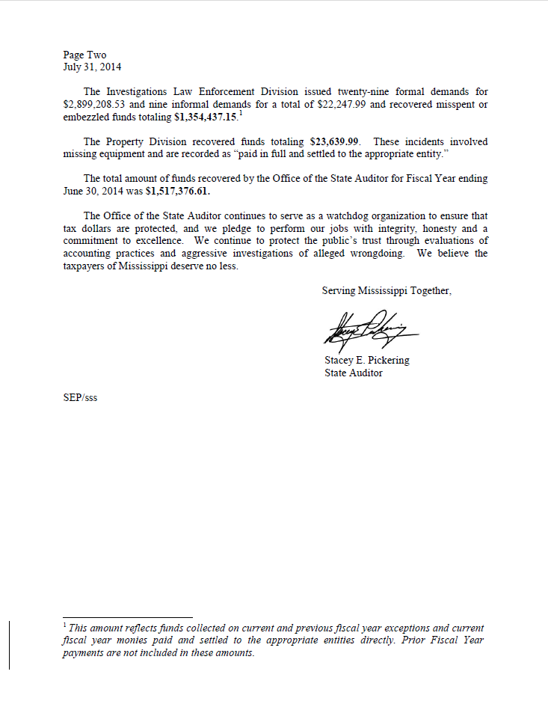
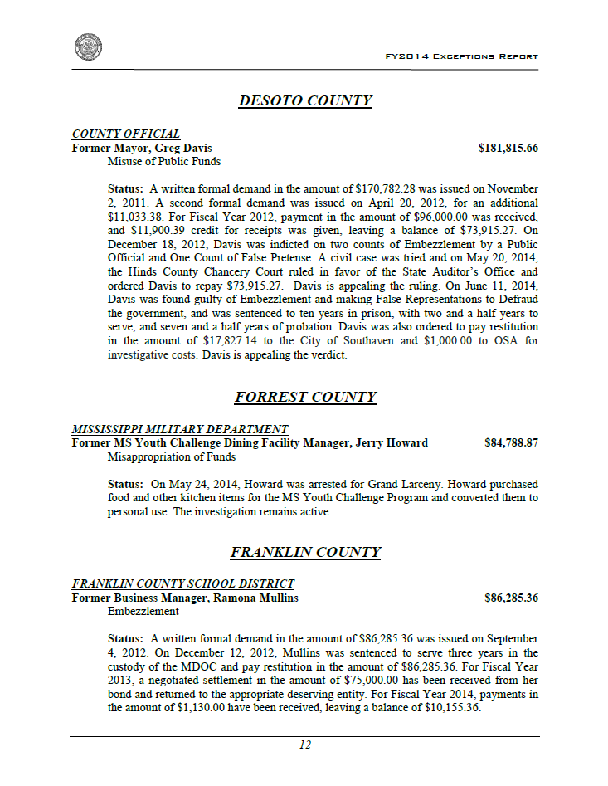
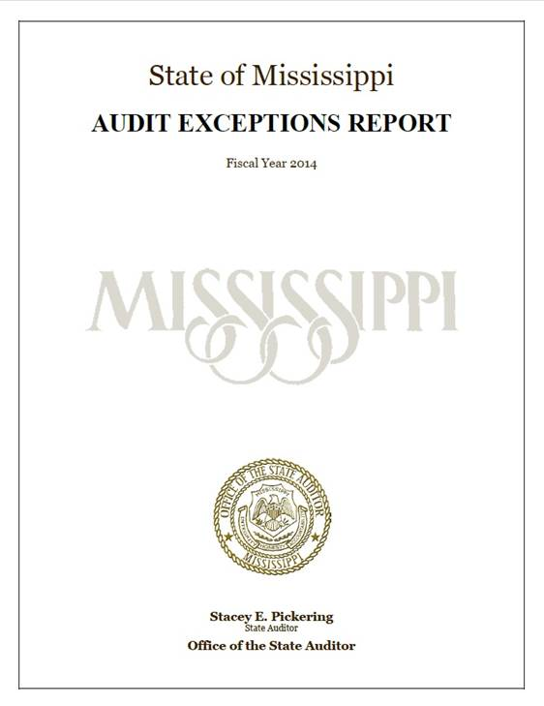
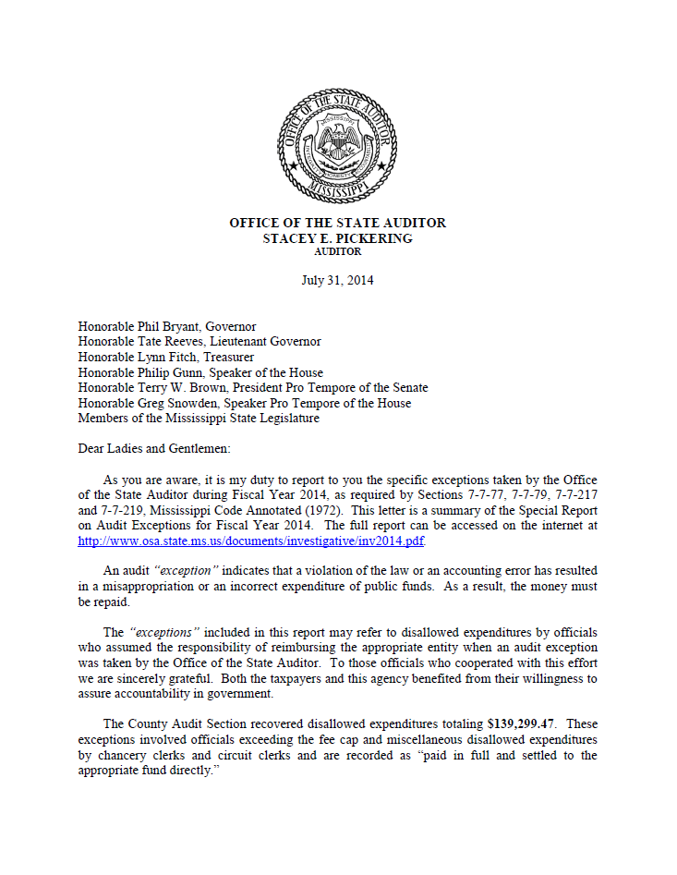
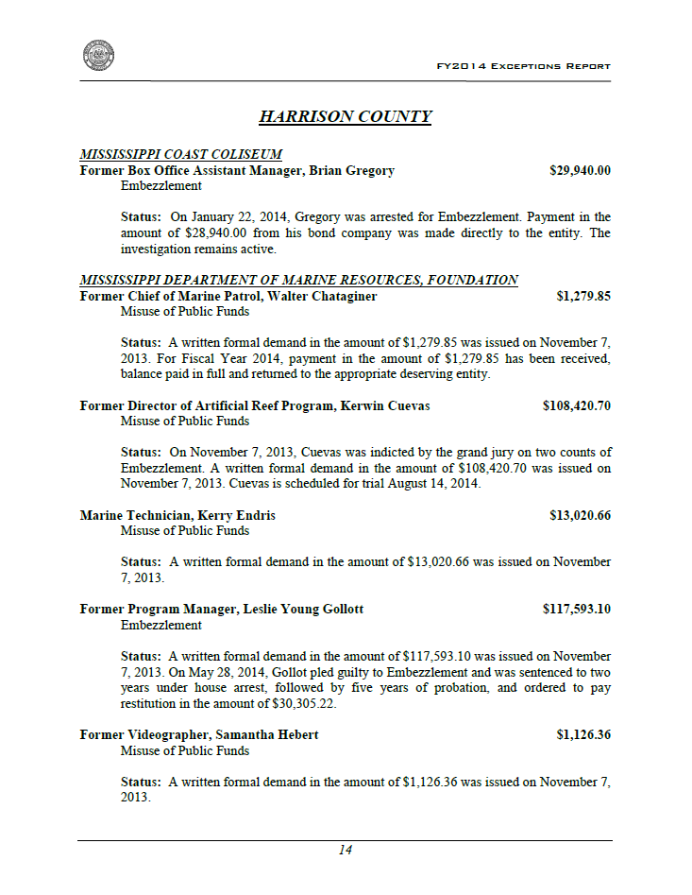



Slide 3
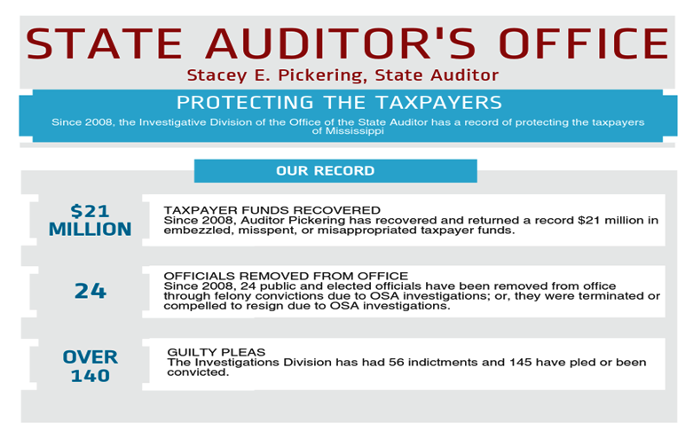

Slide 4
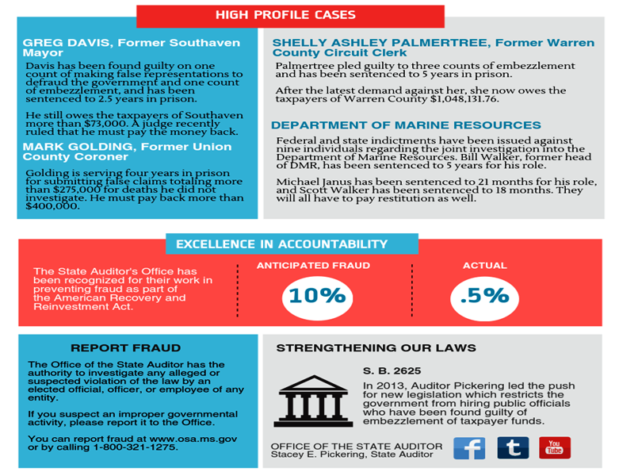

Slide 5
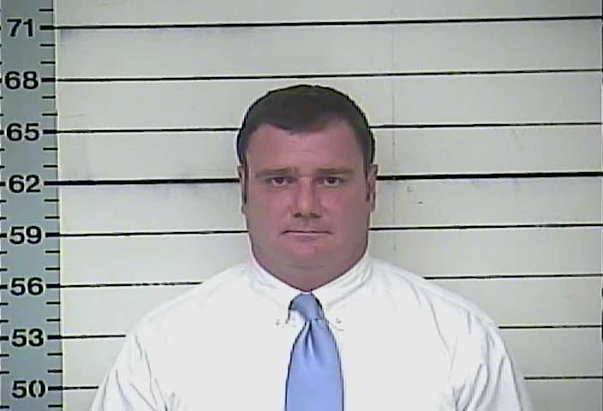
Greg Davis, former Southaven Mayor
Misuse of public funds
Civil trial
  Written demand for $170,000 issued in 2011
  Hinds County Chancery Court ruling
  Must repay remaining $73,915.27
Criminal trial
  Guilty of Embezzlement and making False Representations to Defraud the Government
  Sentenced to serve 2.5 years
A few of the places Davis expensed to the city…

Slide 9
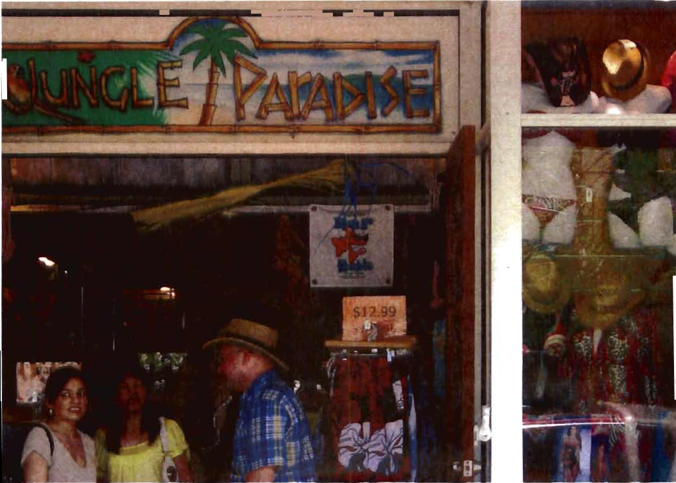

Slide 10
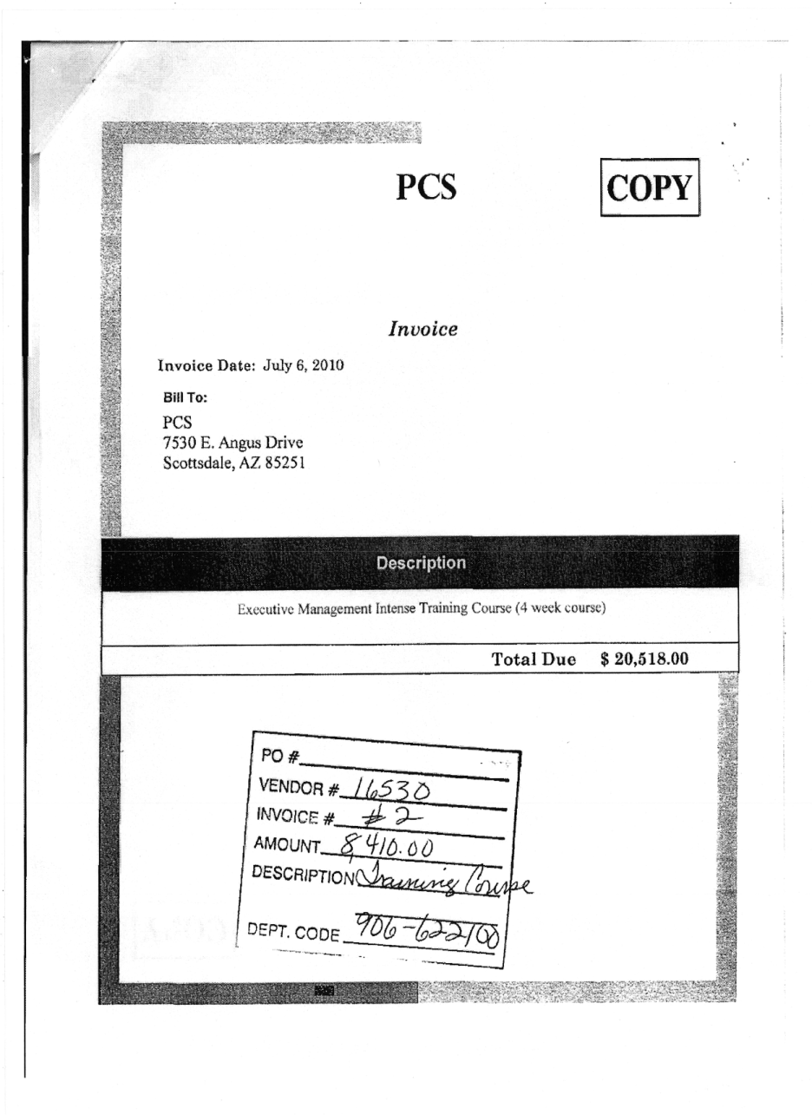
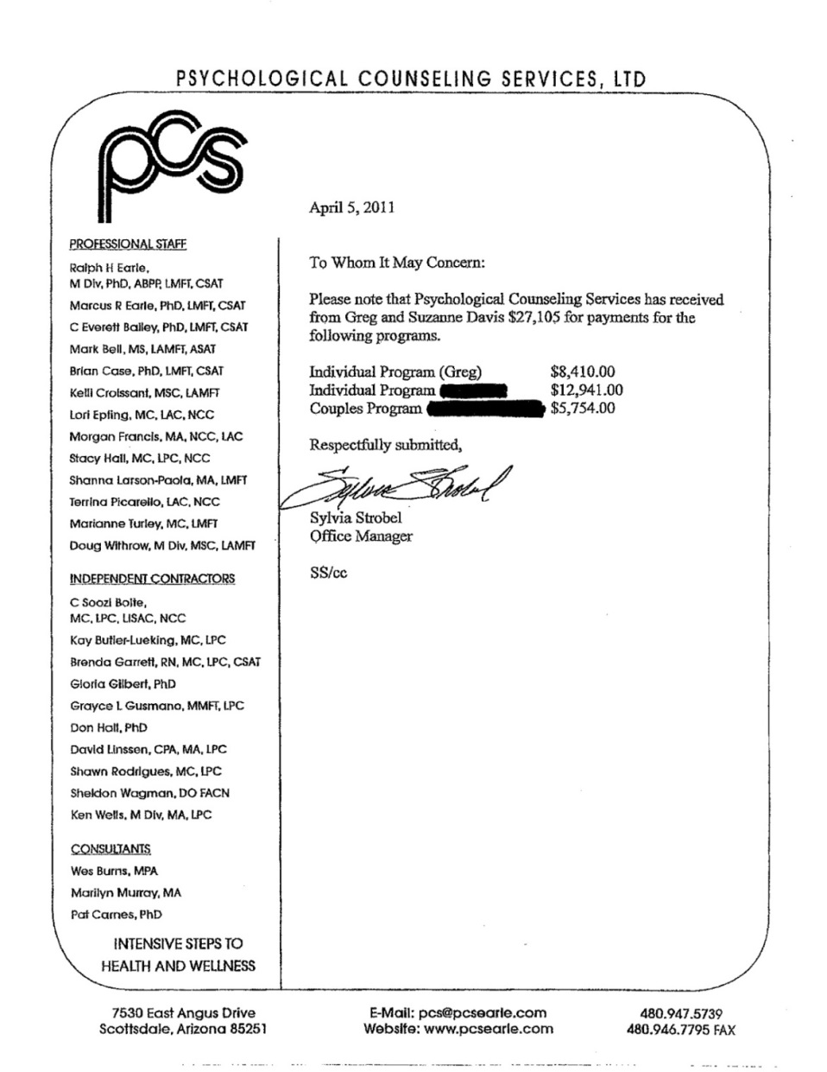

Slide 11
When You Make The Jay Leno Monologue…

Slide 12


Slide 13
Mark Golding, former Union County Coroner
Submitted false claims for deaths he did not investigate
Discovered during annual county audit by OSA
Sentenced to serve four years in prison
Ordered to pay nearly $400,000 in restitution
Forfeited all interest in state retirement

Slide 14
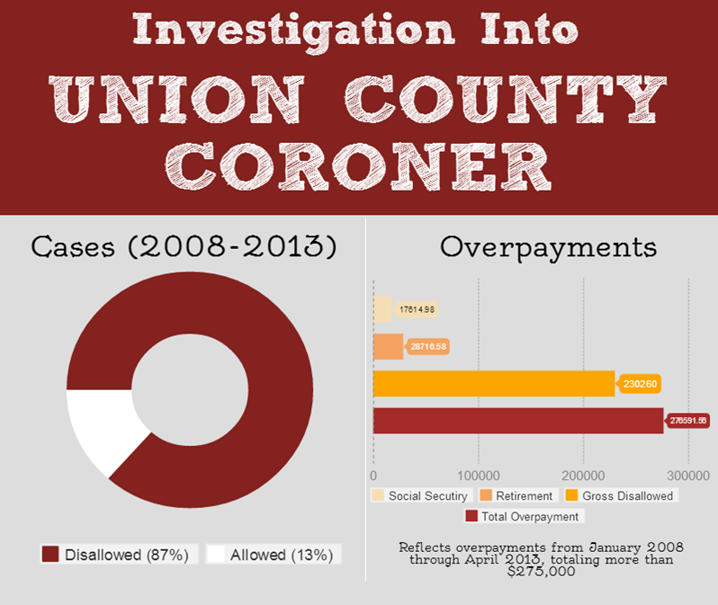

Slide 15
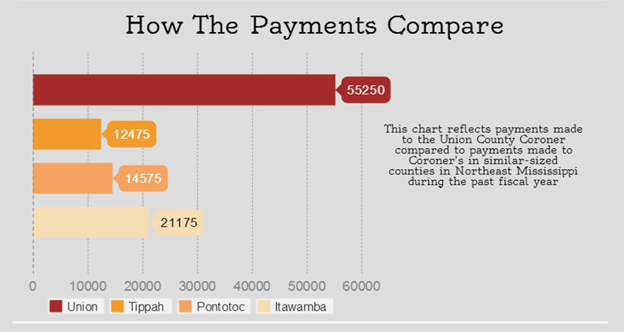

Slide 16
Department of Marine Resources
William Walker, former Executive Director
  Sentenced to 5 years in prison
  Ordered to pay nearly $700,000 in restitution and fines
Scott Walker, former Consultant
  Sentenced to 18 months in prison
  Ordered to pay $390,000 in restitution
Michael Janus, former D’Iberville City Manager
  Sentenced to 21 months in prison
  Ordered to pay $180,000 in restitution
More than $1.5 million in demands, restitution and fines

Slide 17
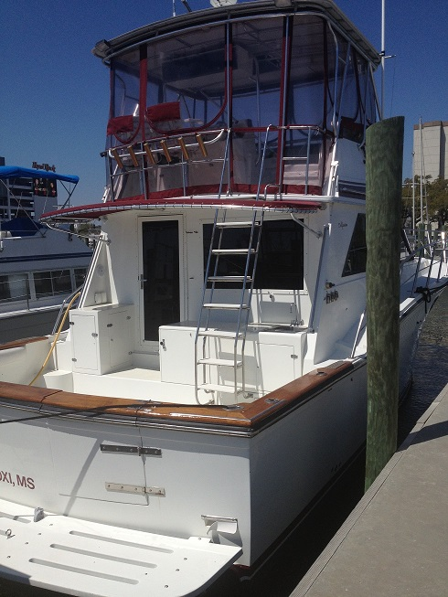
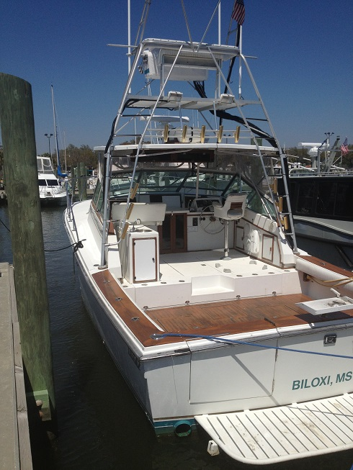

Slide 18
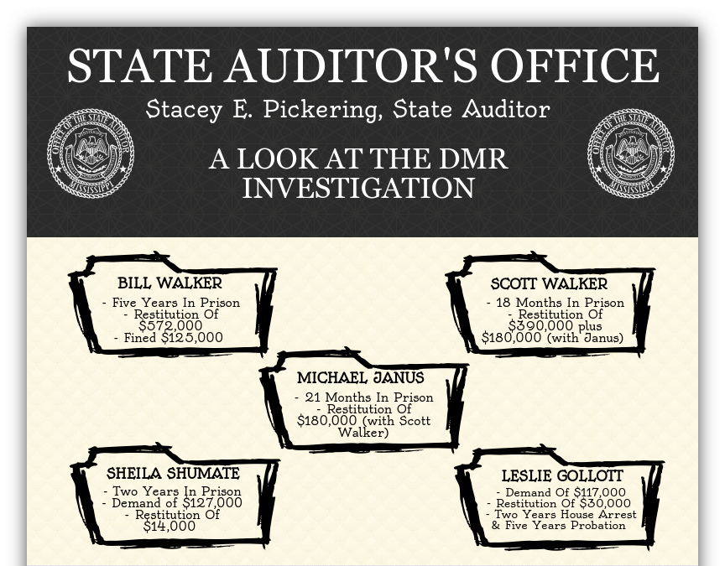

Slide 19
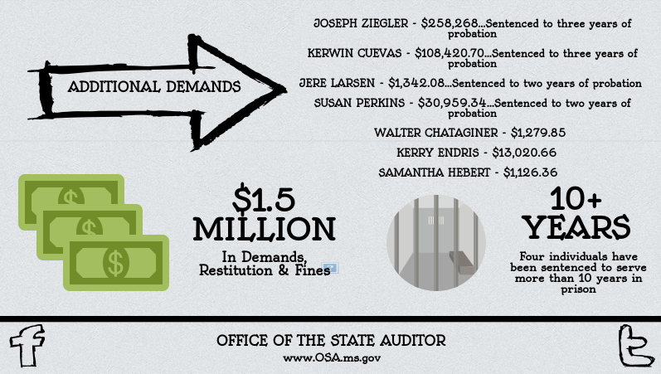

Slide 20
Billy Joe Landrum former 18th District Circuit Judge
Uncontested, sitting judge for 28 years
Mishandled Jones County Community Services Program funds for fuel, vehicle, security officer salaries, employer salaries, and private travel.
The investigation found $4,699.52 in fuel purchases; $82,637.77 for vehicle purchases and $197,439.50 in courtroom security officers' salaries and employer salary expenses
Issued a demand for $313,726.73.

Slide 21
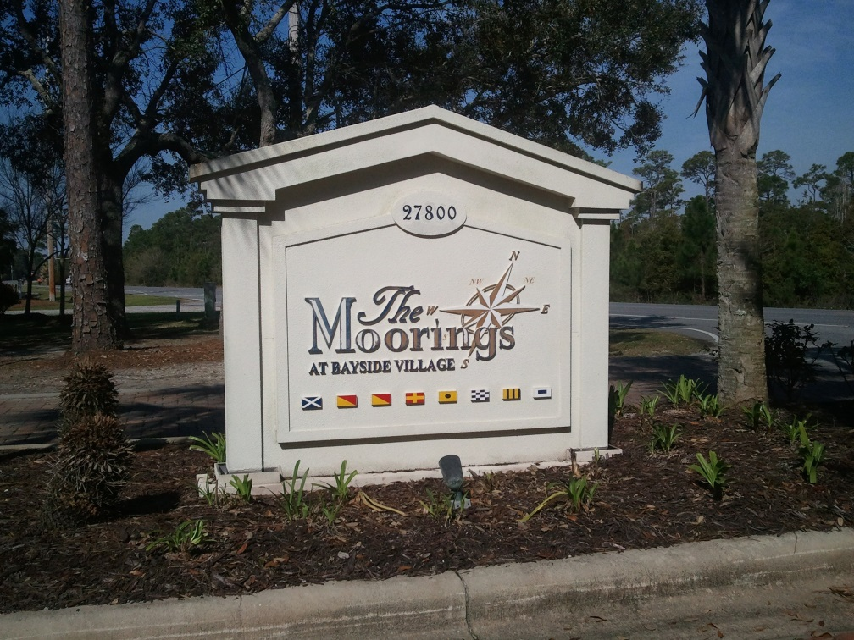
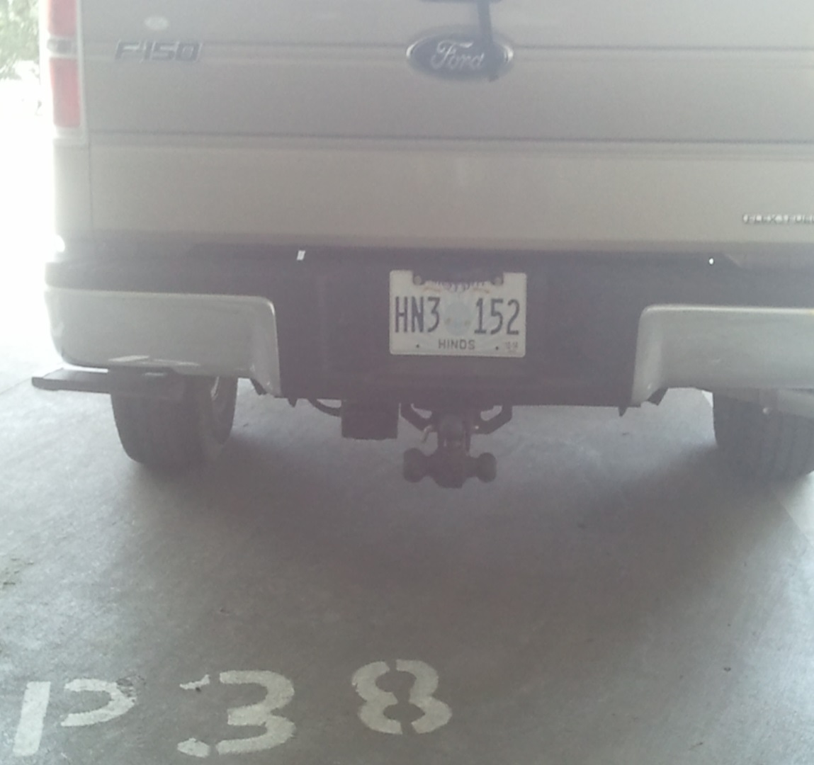
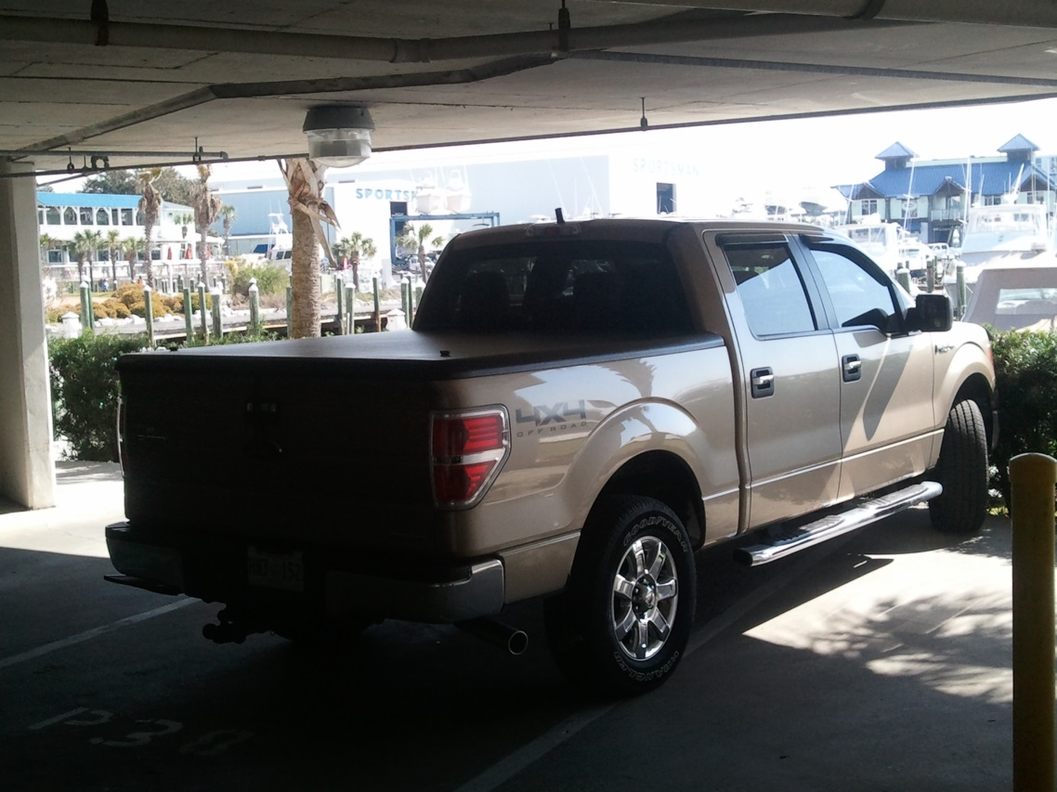
“If the auditor believes that I'm going to sit here and suggest that Judge Landrum has done anything illegal or unlawful, then he's the state auditor of la-la land.” –Tom Fortner

Slide 22
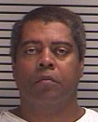
James Terry, former Lowndes County Supervisor
Convicted of Embezzlement in 2007
Used county owned vehicle for
  personal use
Sentenced to 13 months in prison
Ordered to pay restitution totaling $6,931.68
Appeal was rejected by Mississippi Supreme Court & U.S. District Court

Slide 23
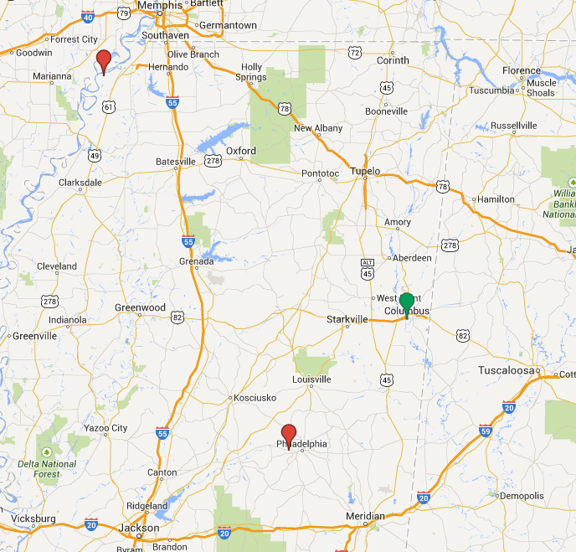

Slide 24
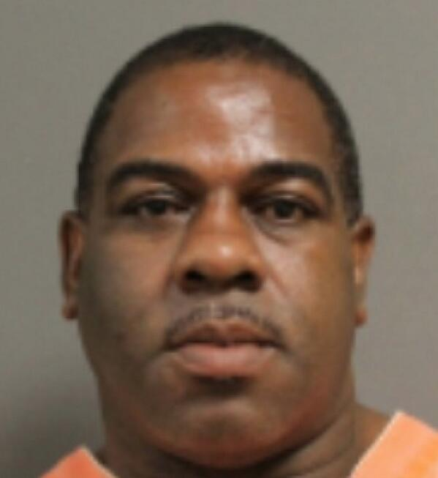
Jerry L. Howard
Former Cafeteria Manager at the Mississippi National Guard Youth ChalleNGe Academy at Camp Shelby
    Owner of Jerry’s Seasoned Food
As enrollment stayed the same, food
  purchases increased by $90,000.
    Had food stored at his home and restaurant
Arrested for Grand Larceny on May 24, 2014
Released on a $10,000 bond on May 27.
On August 20, 2015, Howard was indicted by a Forest County Grand Jury on four counts of embezzlement.
On September 14, 2015, Howard was issued a formal demand in the amount of $157,385.40.

Slide 25
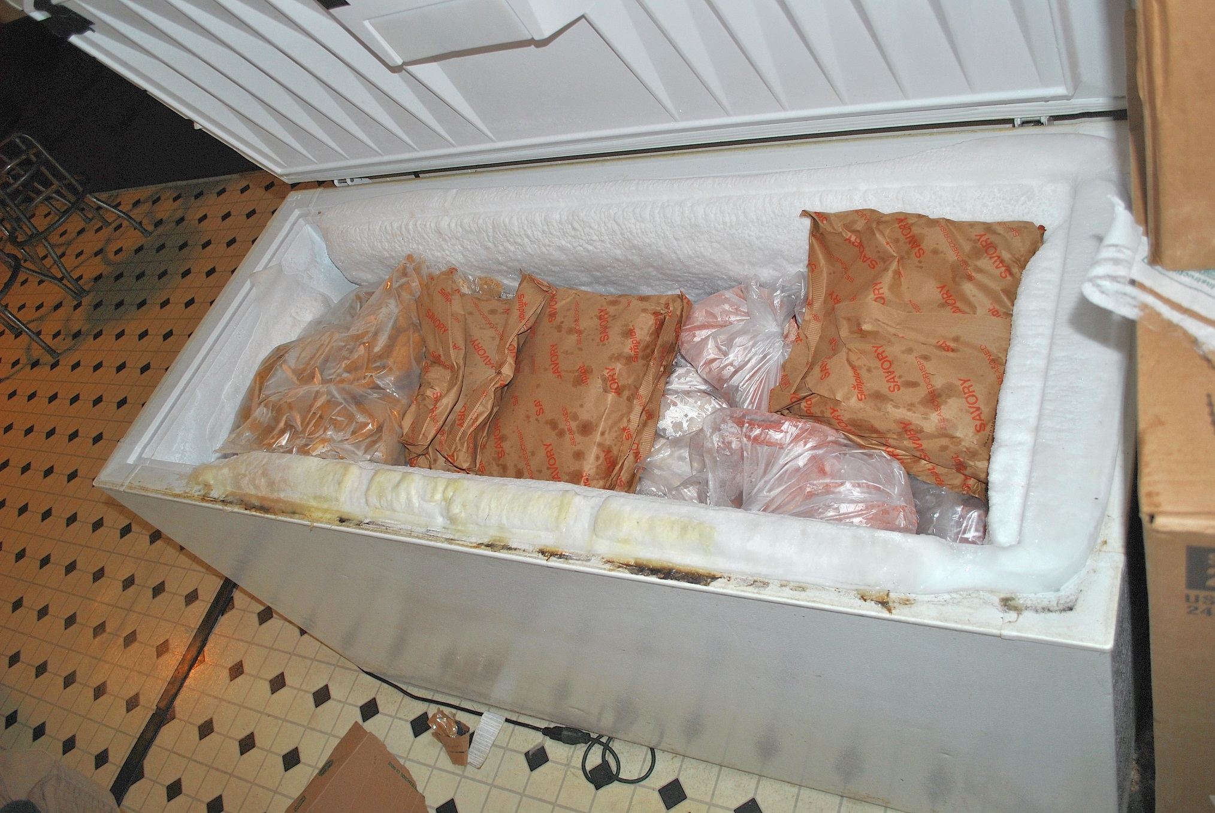

Slide 26
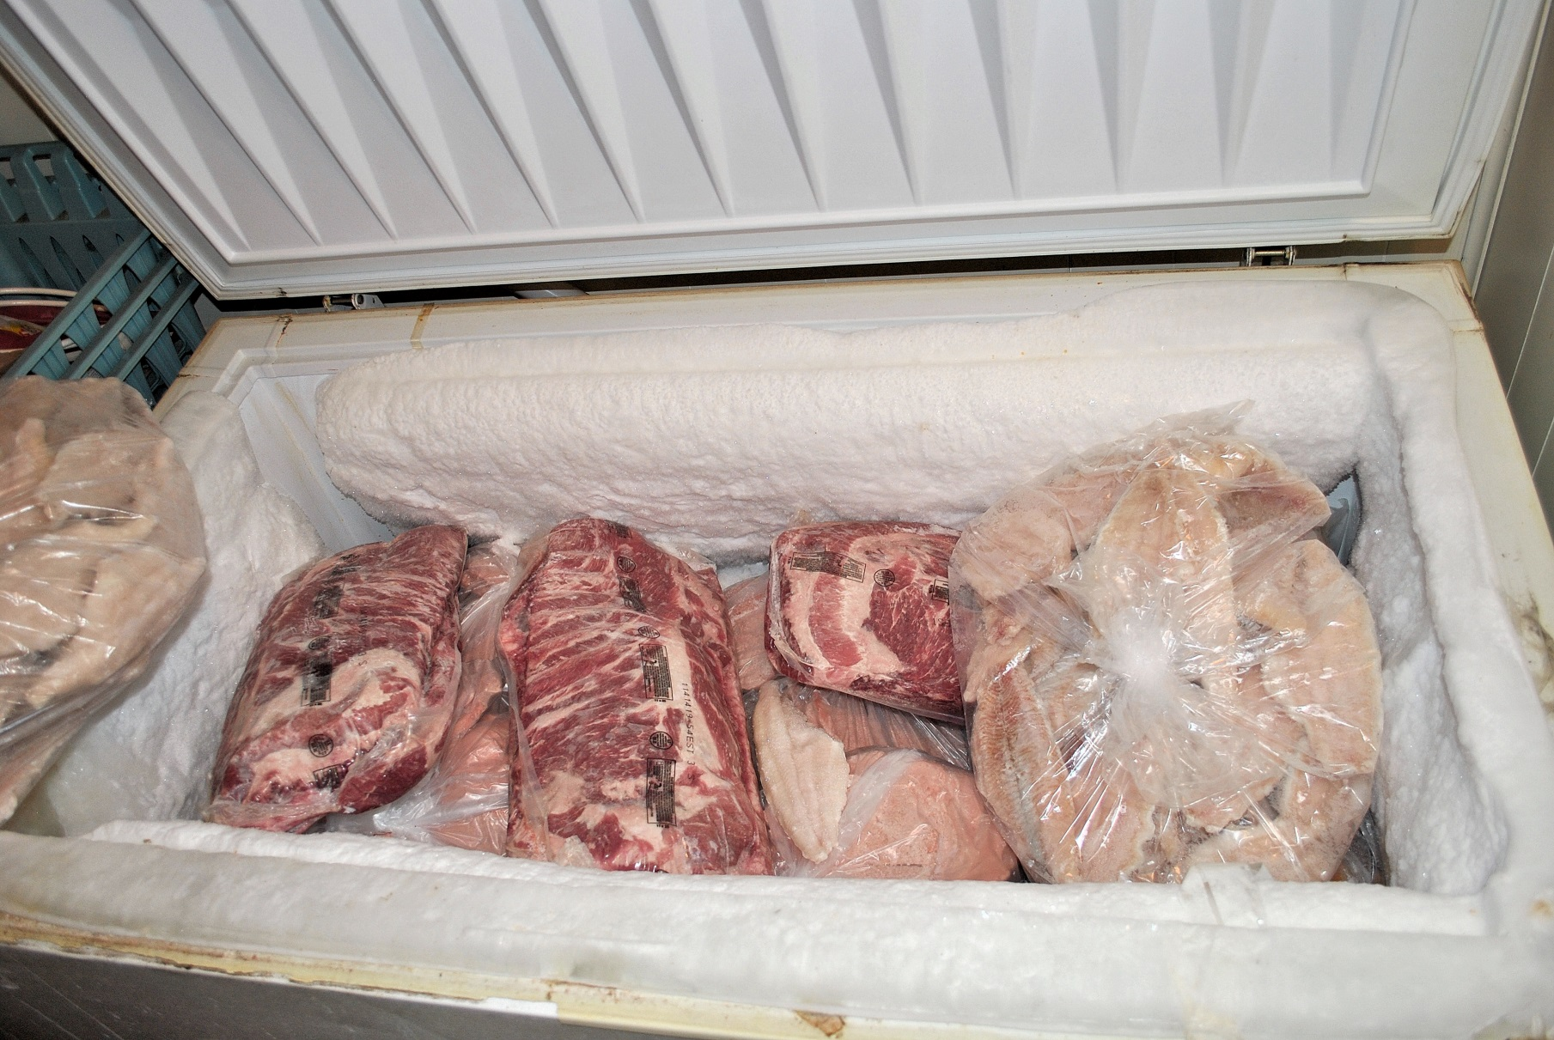

Slide 27
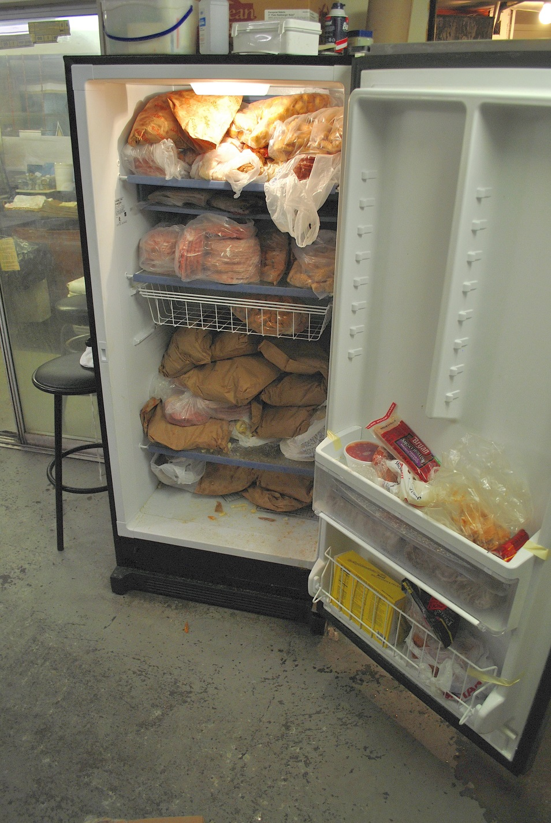
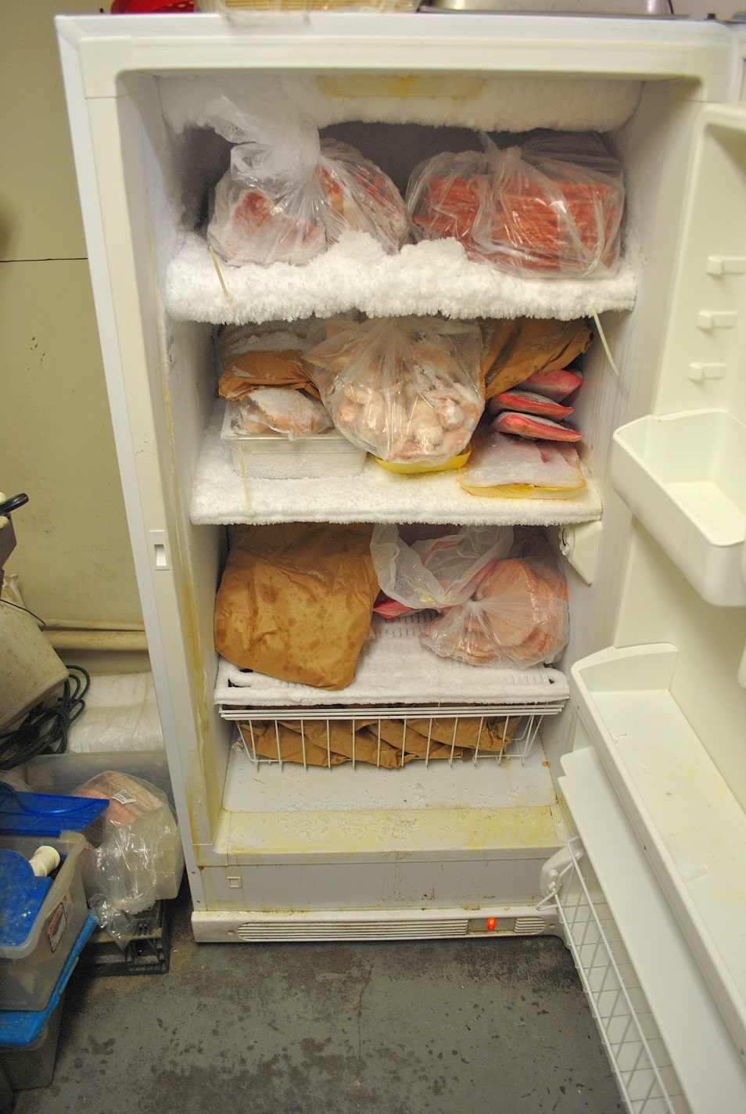

Slide 28
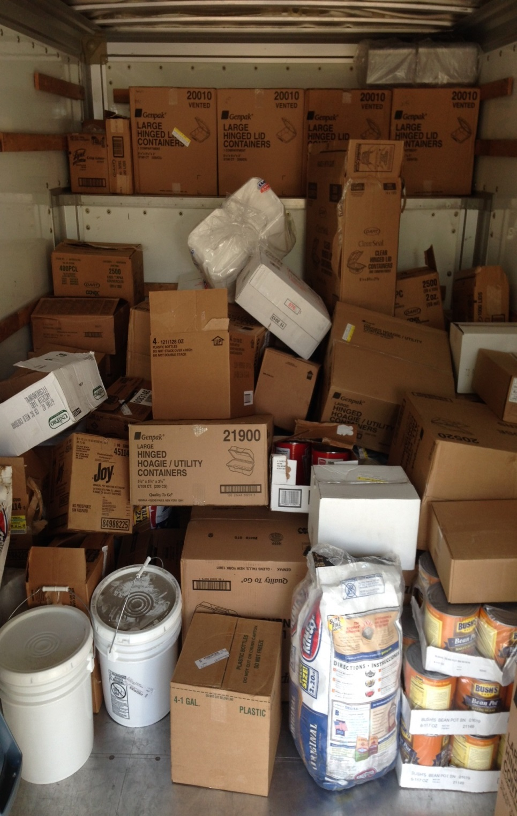
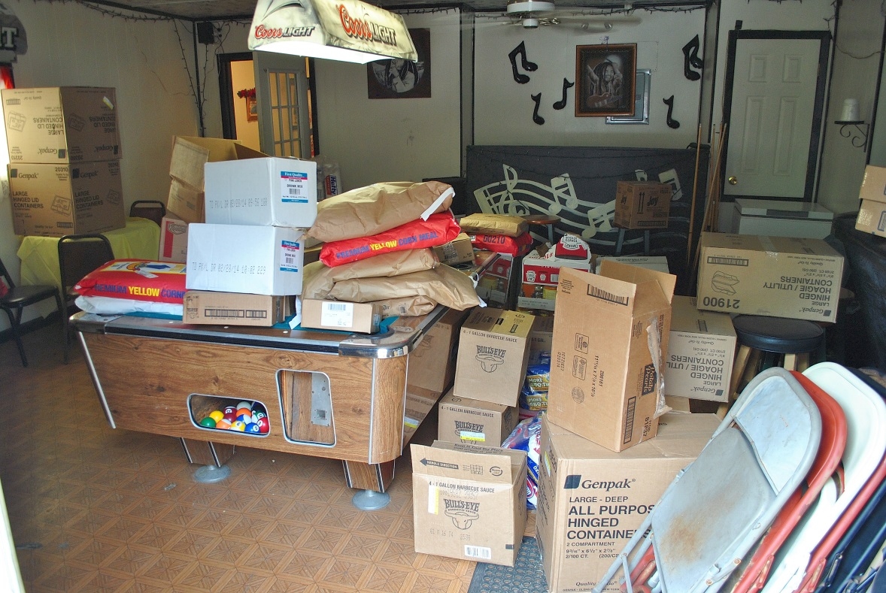
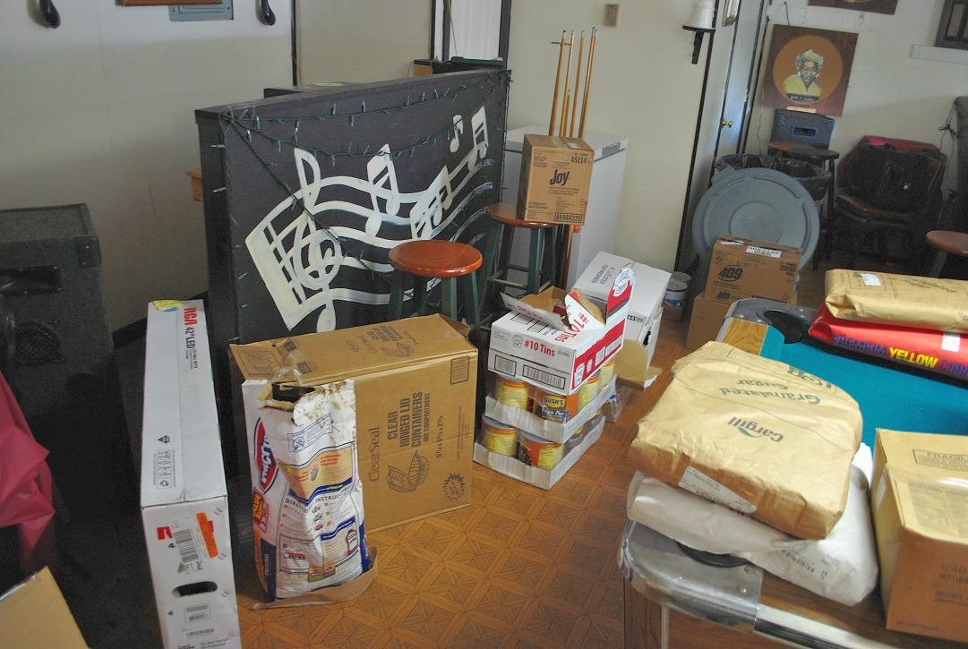

Slide 29
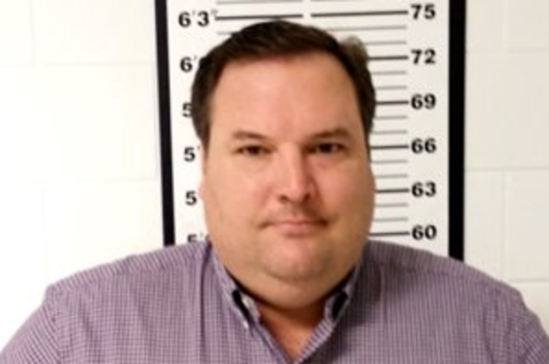
Alcorn County
Jimmy Dallan Nelms
  Former 2nd District Supervisor
  Pled guilty to false representation
    to defraud government,
    fraudulently obtaining
    public funds, and embezzlement.
  Received 30 years in the custody of the MS Department of Corrections with 18 of those years suspended and 12 years to serve followed by 5 years of post-release supervision, and restitution in the amount of $308, 244.71, $5,000 in fines, and court costs in the amount of $3,157.50.

Slide 30

Alcorn County
William Paul Rhodes
  former Alcorn County Purchasing clerk
  Pled guilty to hindering prosecution,
    fraudulently obtaining public funds, and
    false representation to defraud government.
  Received 15 years in the custody of the MDOC with 10 of those years suspended, followed by 5 years of post-release supervision, restitution in the amount of $72, 466.28, $5,000 in fines, and court costs in the amount of $1,894.50.

Slide 31
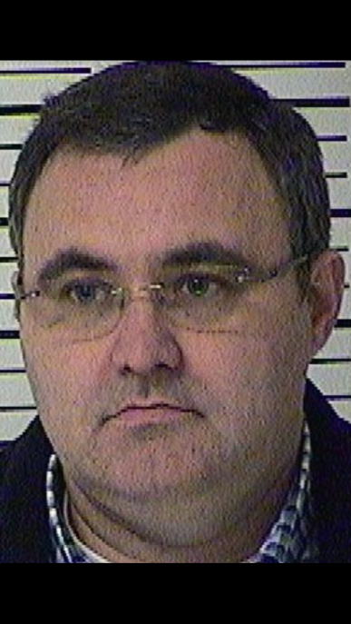
Alcorn County
Jimmy Ray Mitchell
  Alcorn County vendor
  Pled guilty to fraudulently obtaining public
    funds and false representation to defraud
    government.
  Received 5 years in the custody of MDOC, ordered to pay restitution in the amount of $95,382.35, placement in the MDOC intensive supervision program, followed by 5 years of post-release supervision, $5,000 in fines which are suspended, and court costs in the amount of $1,263.00.

Slide 32
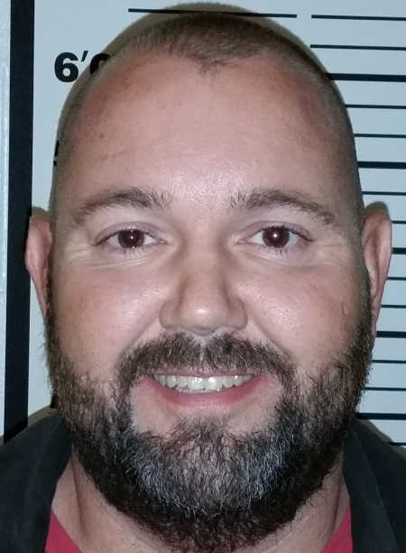
Alcorn County
Joseph Lin McNair, Jr.
  Alcorn county vendor
  Pled guilty to false representation to
    defraud government.
  Received 5 years in the custody of the
    Mississippi Department of Corrections, placement in the MDOC intensive supervision program, followed by 4 years of post-release supervision, $5,000 in fines, and court costs in the amount of $631.50.

Slide 33
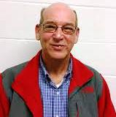
Alcorn County
Danny Roy Peters
  Alcorn County vendor
  Pled guilty to false representation
    to defraud the government.
  Received 5 years in the custody of the MDOC, placement in the MDOC intensive supervision program, followed by 4 years of post-release supervision, $5,000 in fines, and court costs in the amount of $631.50.

Slide 34
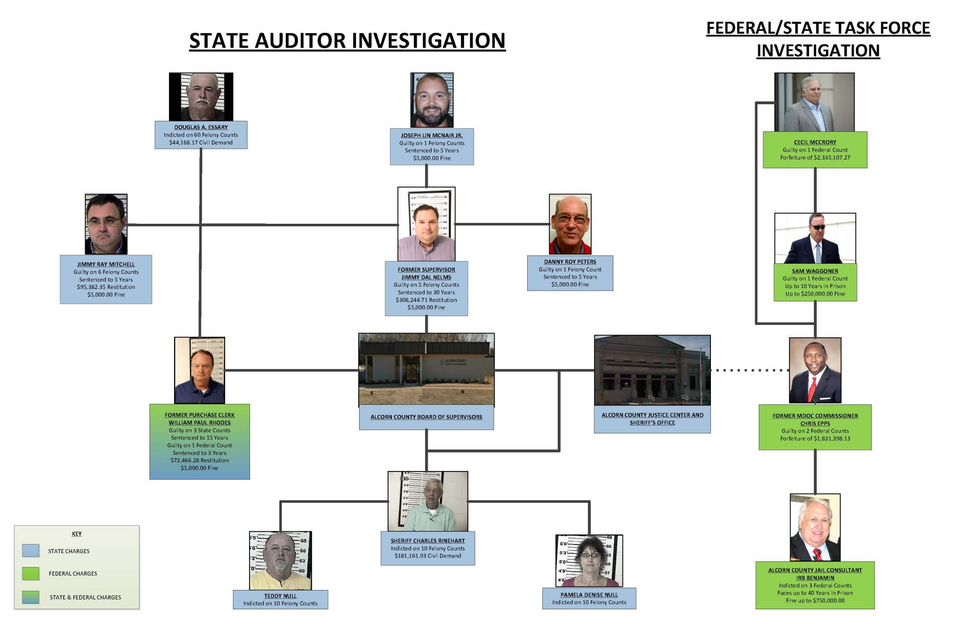
Alcorn County

Slide 35
Thank You!
Stacey E. Pickering
Mississippi State Auditor
P.O. Box 956
Jackson, MS 39205
Ph: 601-576-2800
800-321-1275 (statewide)
Website: www.osa.ms.gov
Facebook.com/StaceyPickering
Twitter: @MsStateAuditor
@StaceyPickering

