Slide 1
Recovering From A Natural Disaster
Sam Atkinson
Director of Special Projects and Audit Response
MS Office of the State Auditor
May, 2018

Slide 2
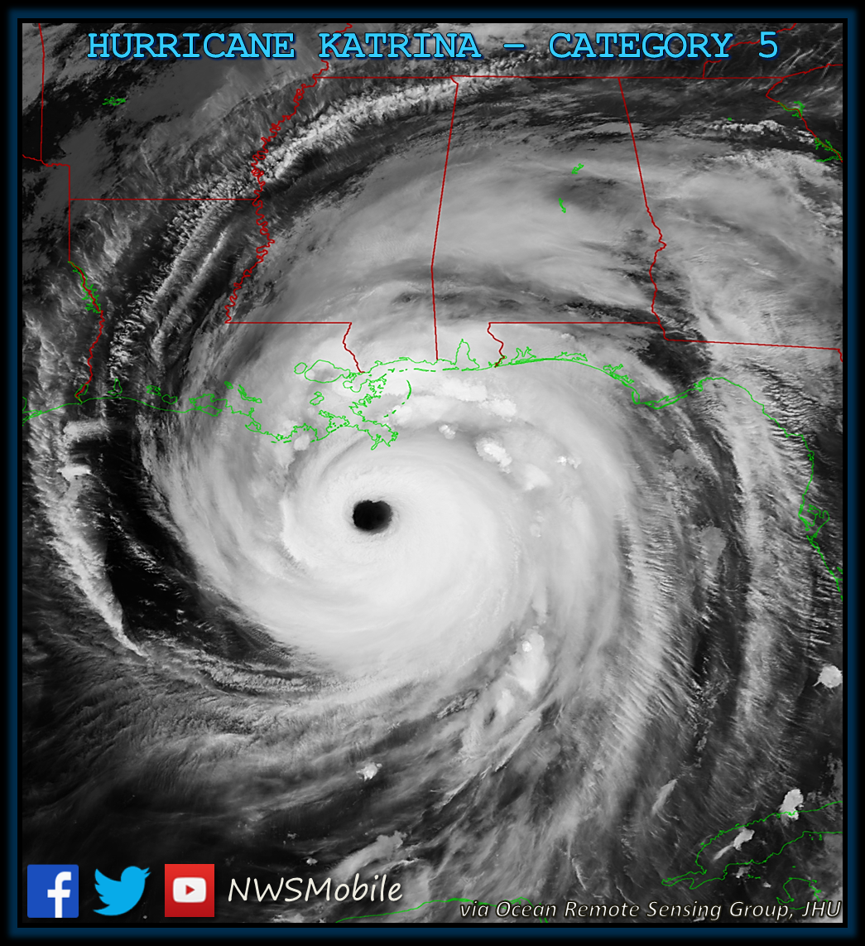
Katrina: August 29, 2005
At 6:10 AM, Katrina made its third landfall as a strong Category 3 hurricane at Bay St. Louis, MS, with sustained winds of more than 125 mph (205 km/h), and gusts over 140 mph.

Slide 3
Katrina: August 29, 2005
Storm Surge
28-37 ft in Bay St. Louis and Waveland, MS
20+ ft. in Biloxi and Pascagoula more than 55 miles away
Destruction and Tornadoes across Mississippi
Survived Camille, Destroyed by Katrina
Buildings, Homes, Roads, Underground Infrastructure—All Destroyed

Slide 4
Katrina: Auditor’s Role
Two days to prepare
Worked with Emergency Management
Prepared Information for Government Officials
Investigators Assigned to Work with Other First Responders
Placed Audit Employees at State EOC
Made Pre-Storm Contact with All OSA Employees

Slide 5
Katrina: The Aftermath
Internal Operations the Day After
Employee Contact
PAYDAY-NO ELECTRICITY
Deploy Staff
External Work Immediately After
Devastating Losses, Public and Private (affecting government services)
PAYDAY

Slide 6
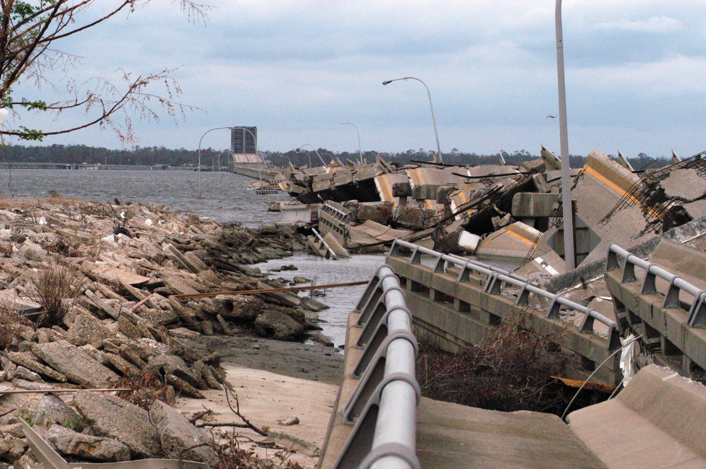
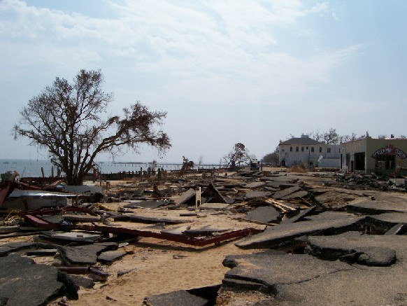
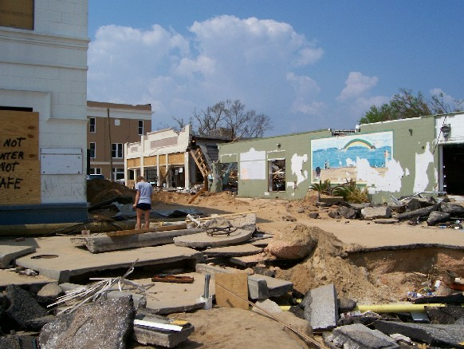
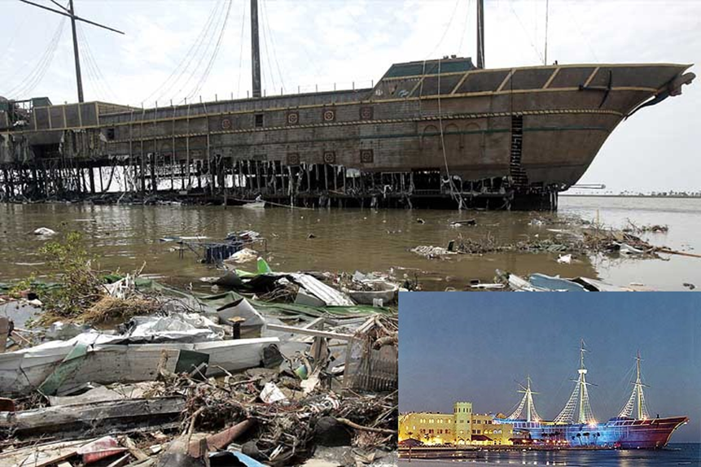
Before and After

Slide 7
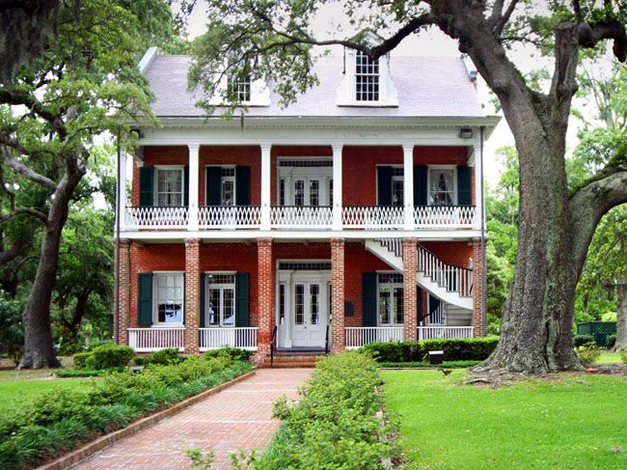
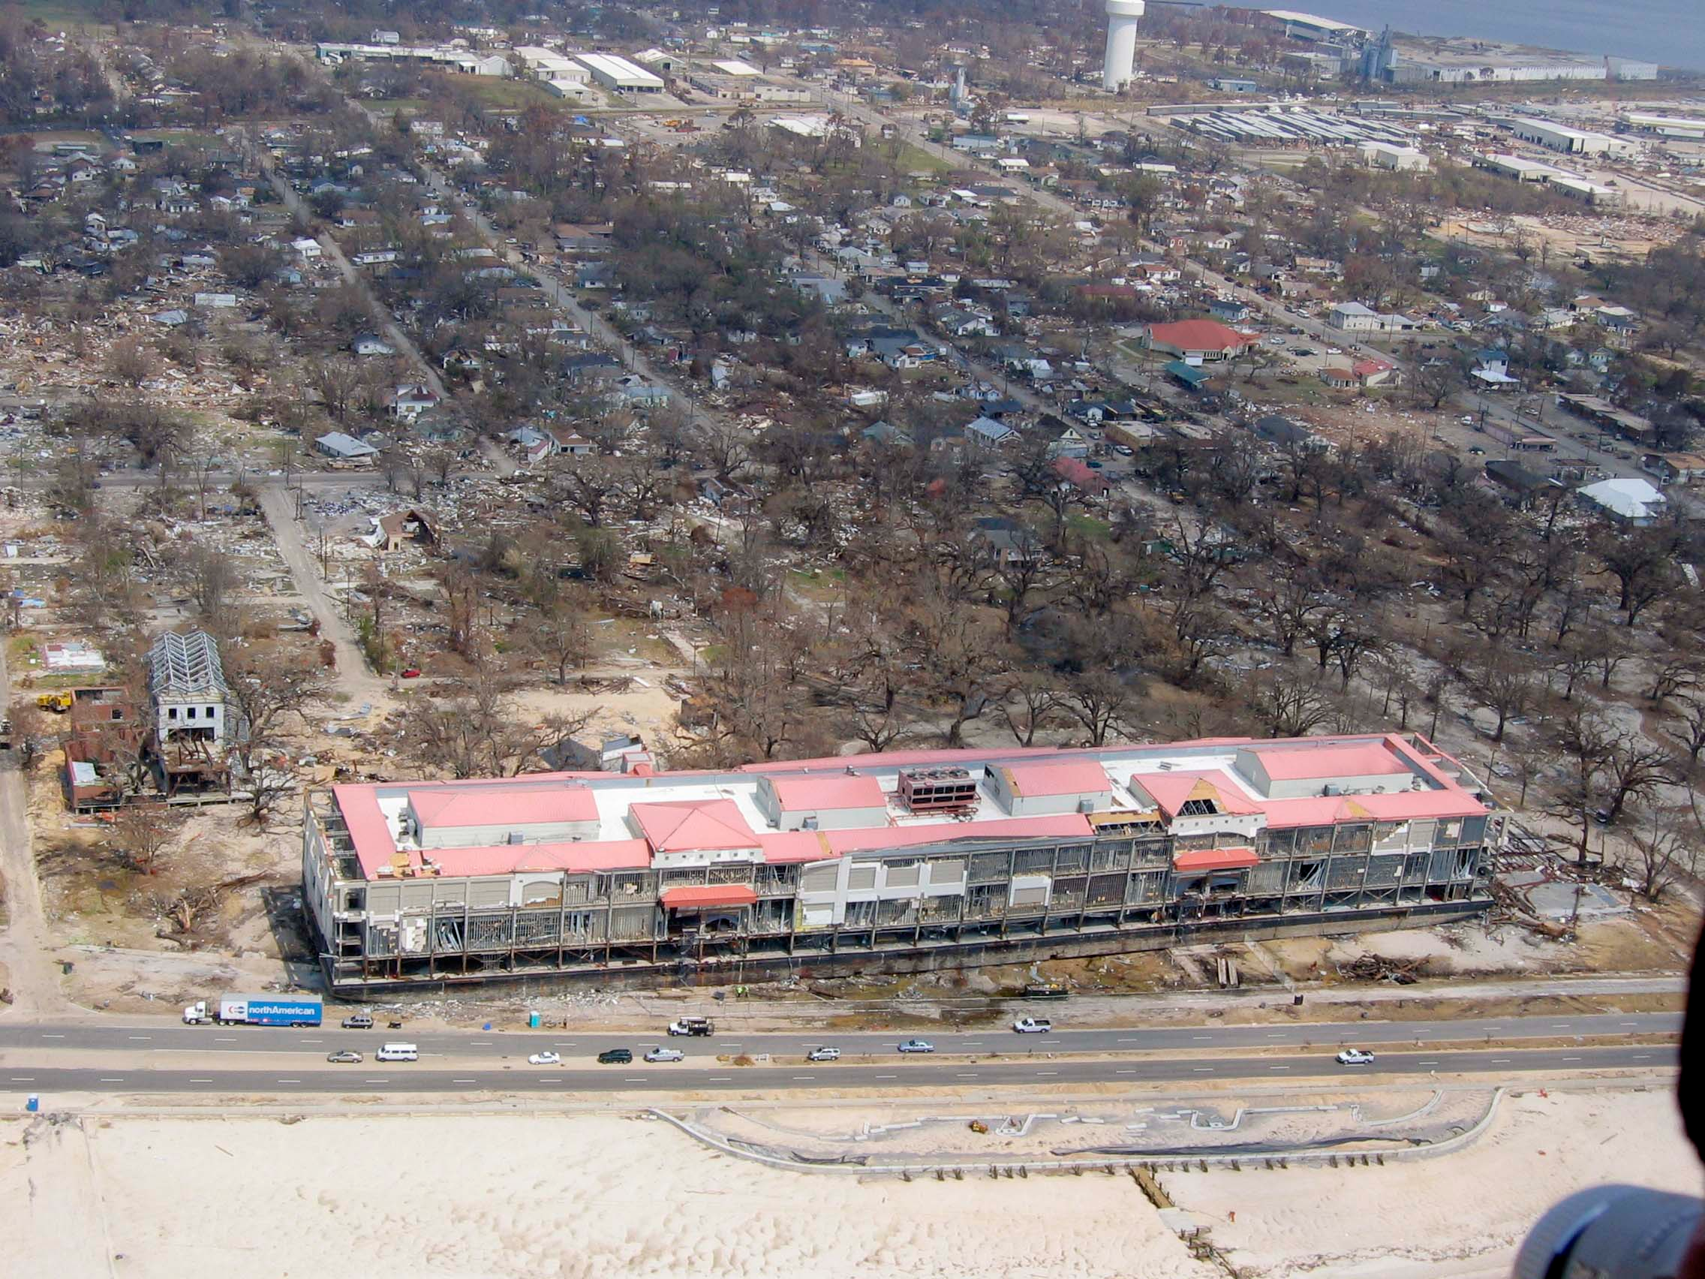
Before and After

Slide 8
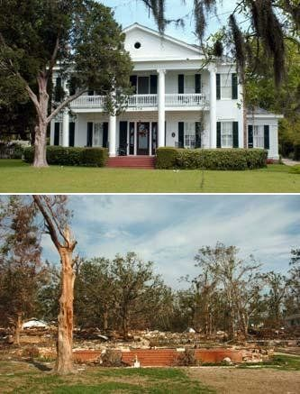
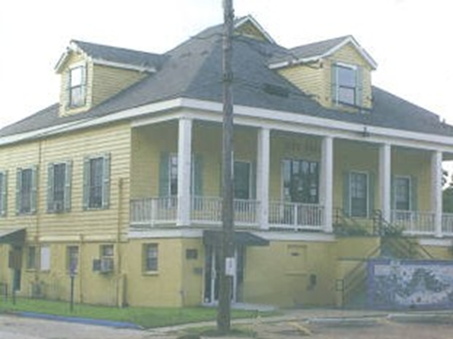
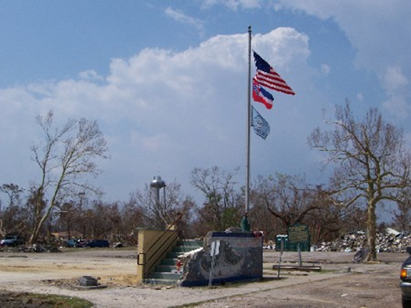
Before and After

Slide 9
Katrina: The Aftermath
Investigators & Financial Auditors
Technical Assistance & Performance Audit
Work with Federal Officials
Review Purchasing/Contracting Laws
Provide Information & Assistance

Slide 10
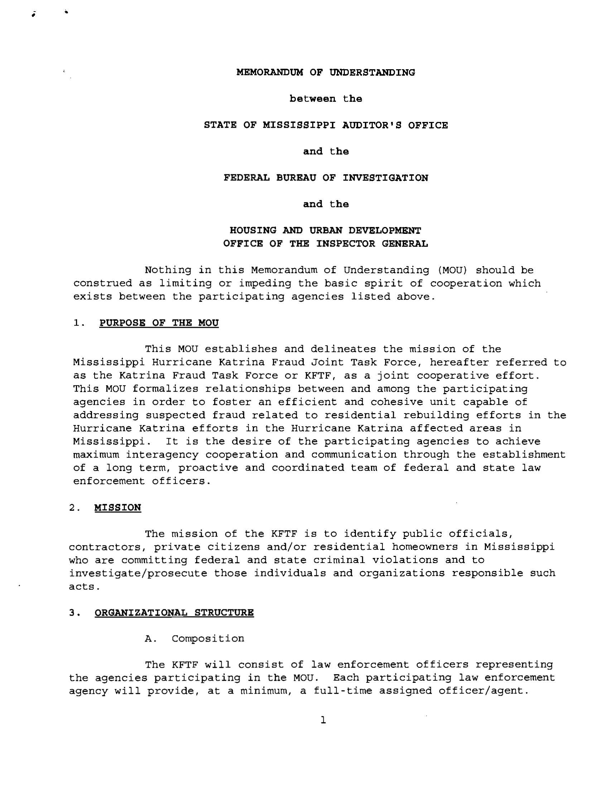
Katrina: Preventing Fraud
Fraud Hotline
Report Fraud Advertisements
Katrina Fraud Unit
Federal/State Team with FBI, USAG, Homeland Security, FEMA, and OIG
Estimated < 0.5% Undetected Fraud in MS

Slide 11
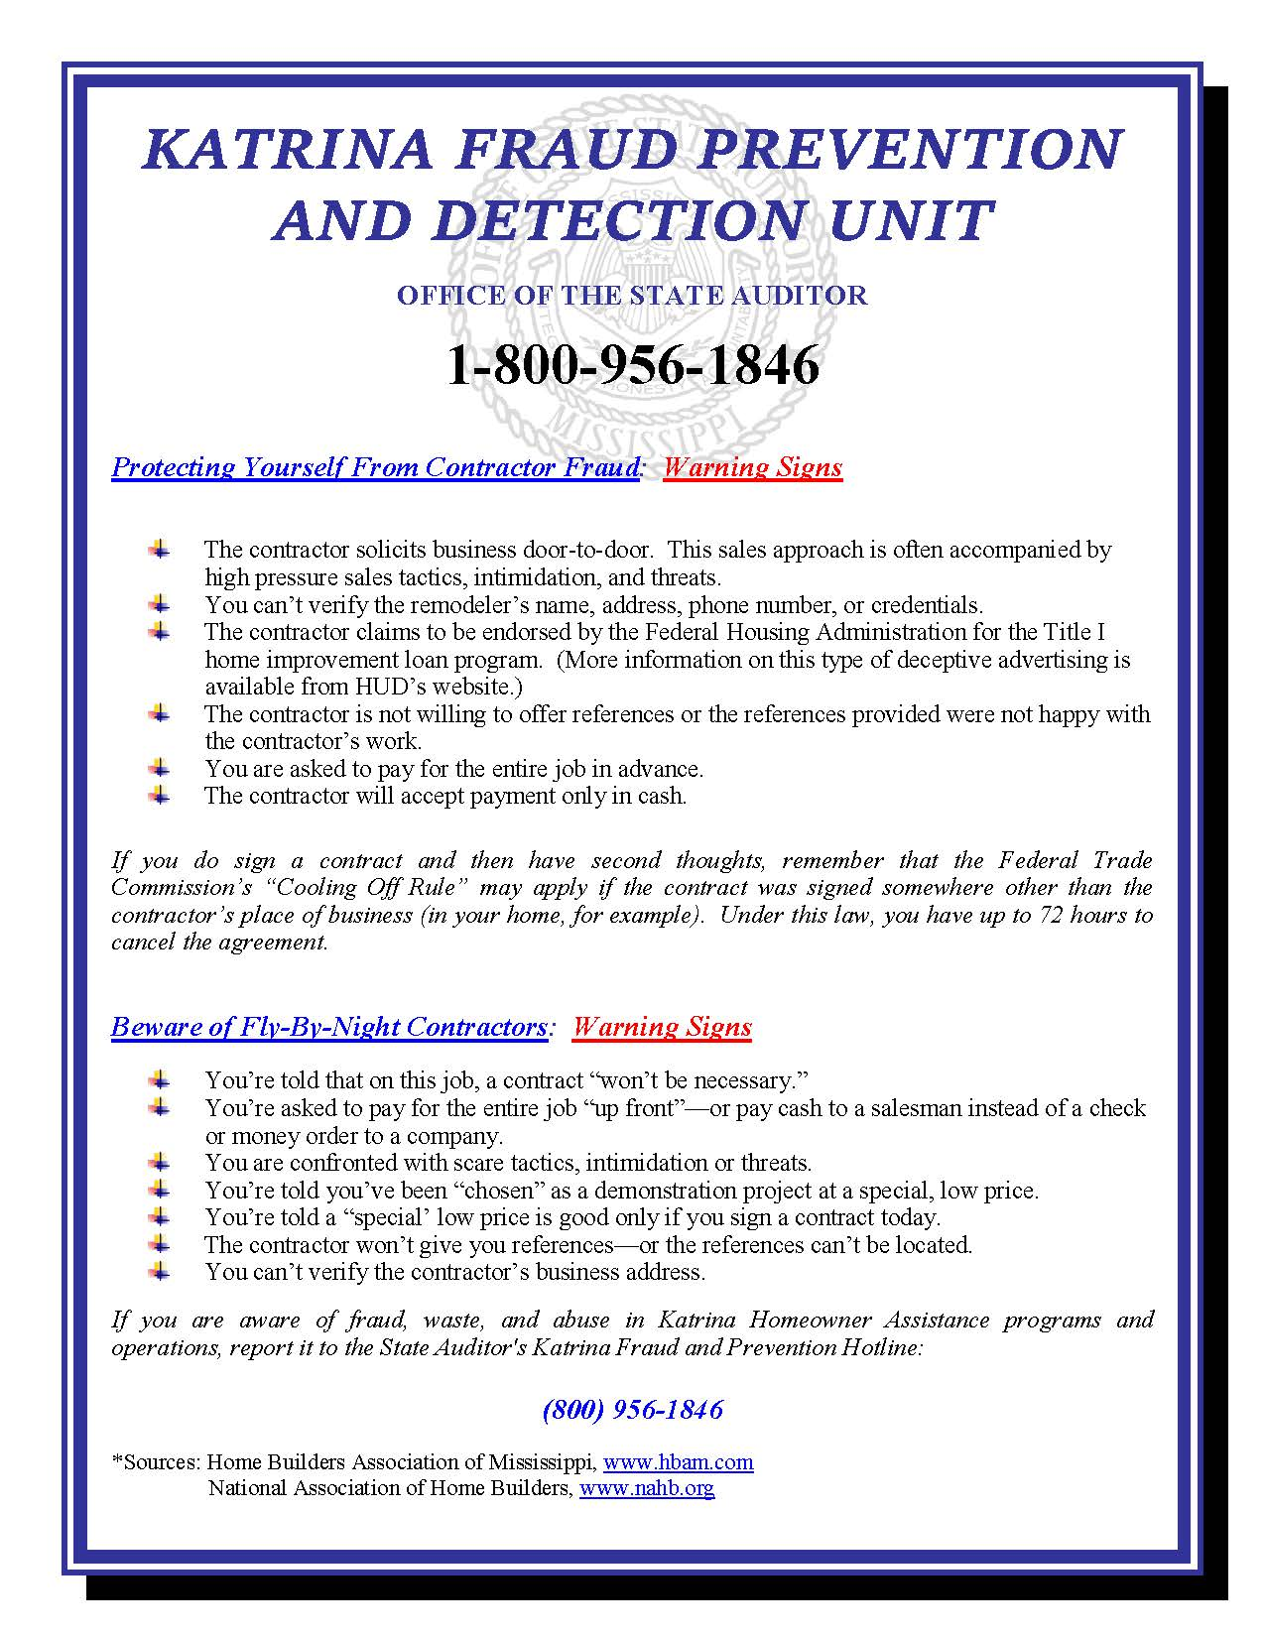
Fraud Prevention
For Homeowners and Businesses
Provided to local government officials for distribution
Provided to radios, newspapers, and TV stations to raise awareness

Slide 12
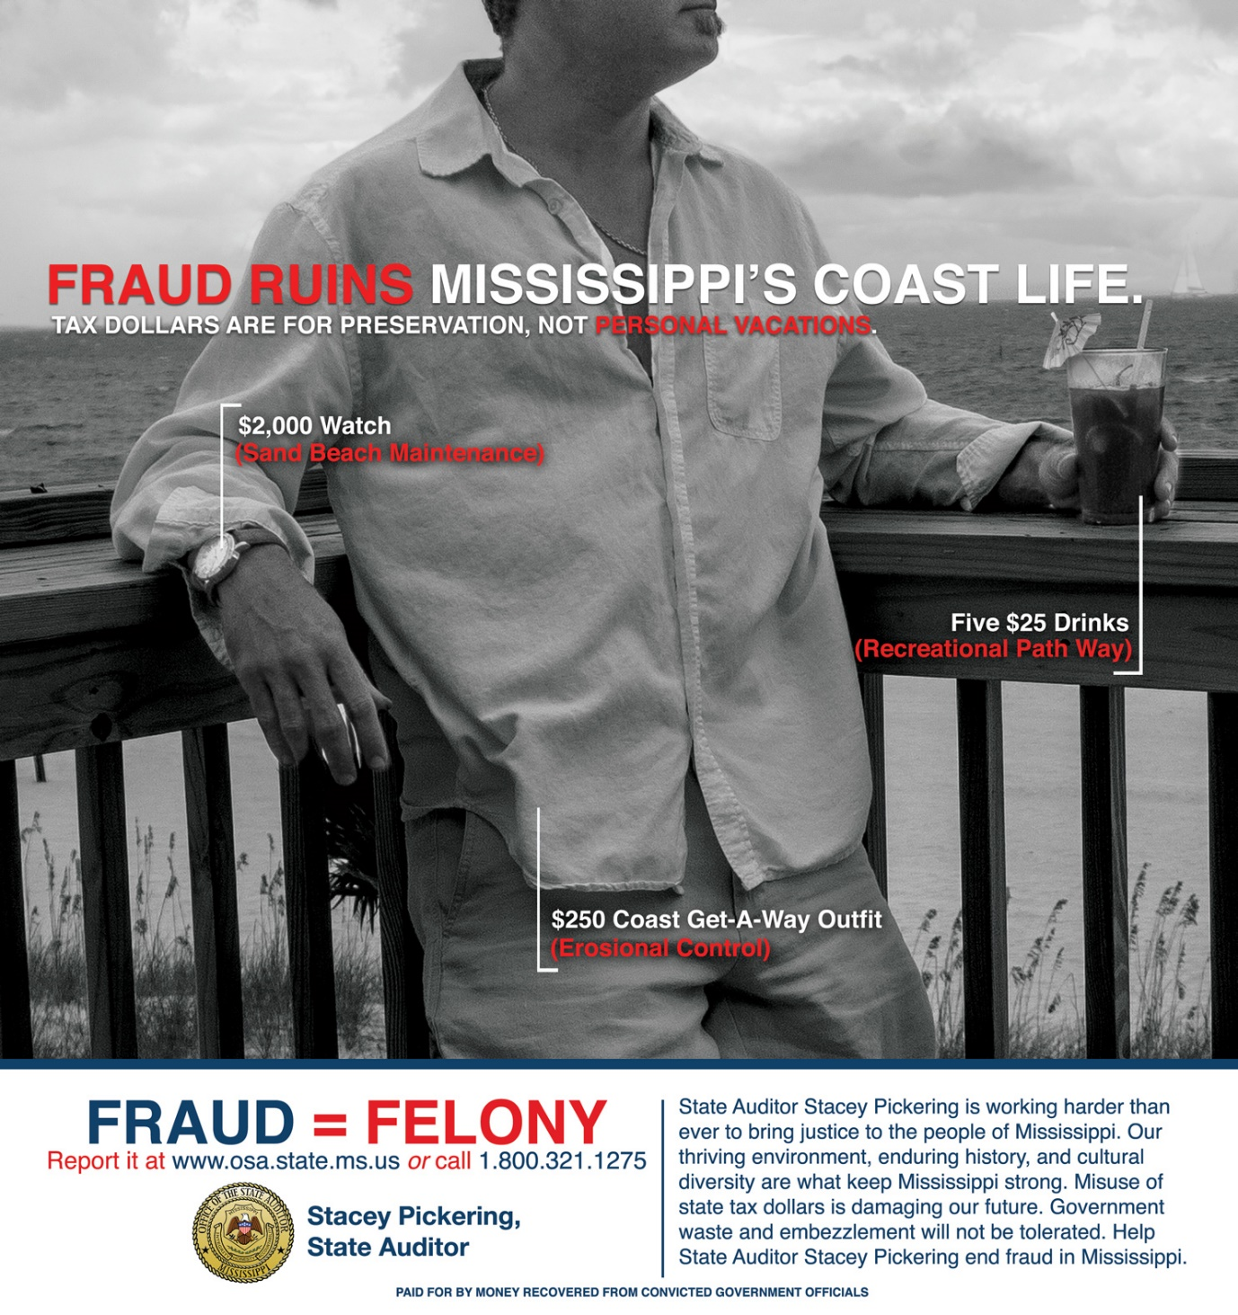
Long Term Fraud Prevention

Slide 13
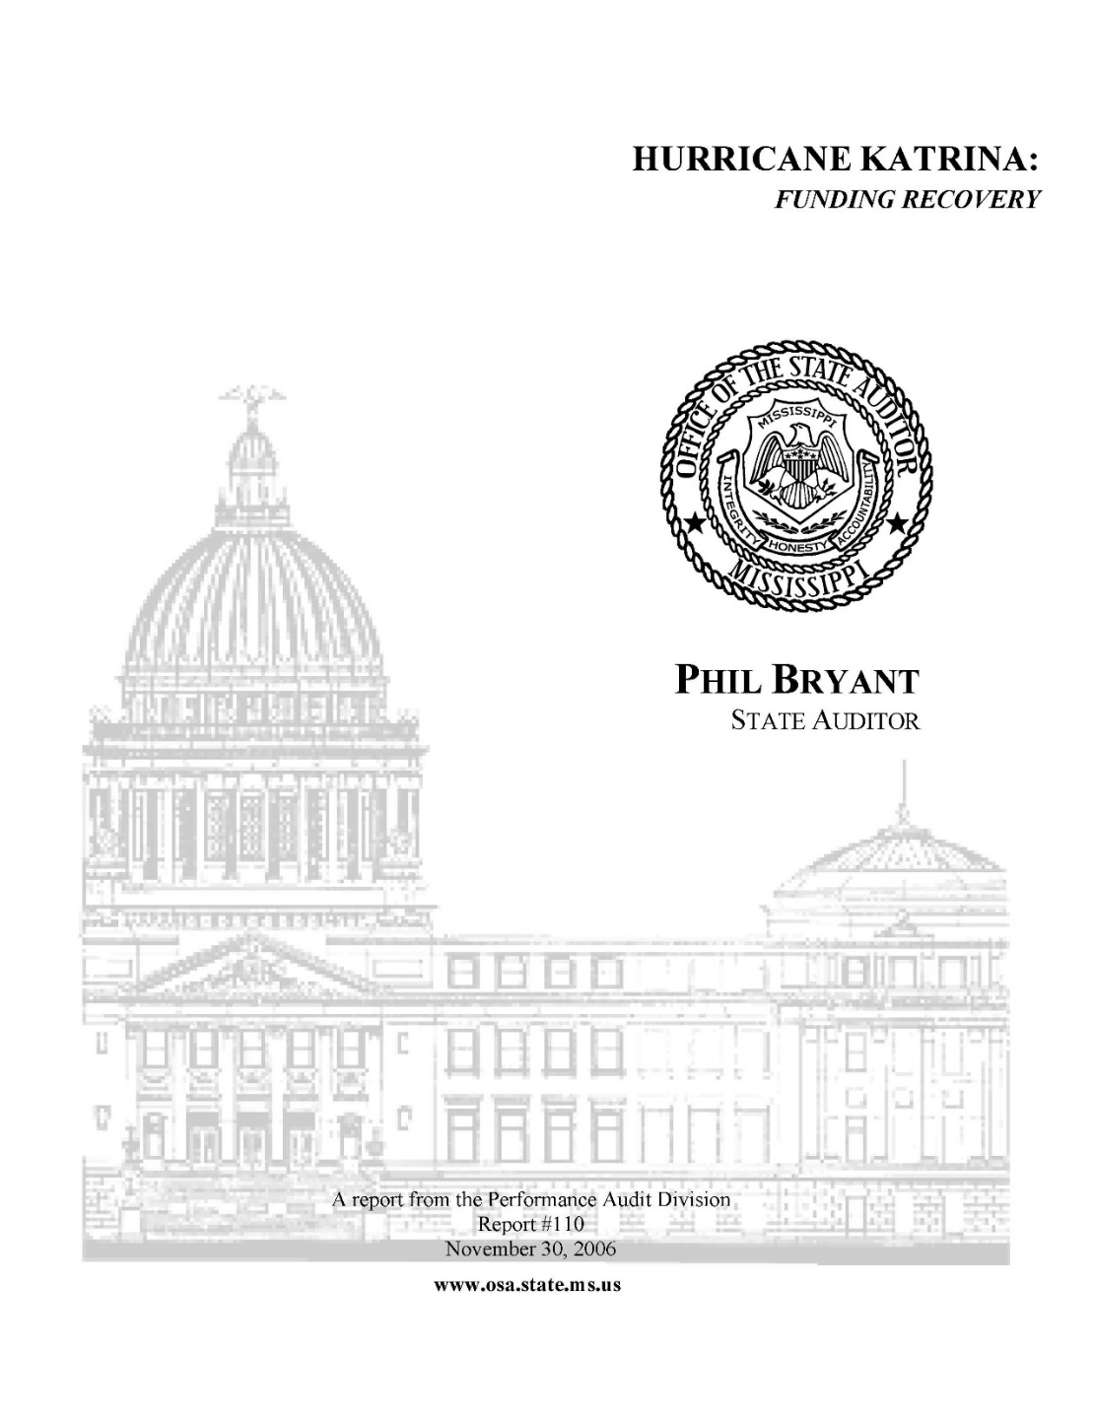
Katrina: The Later Years
Tracked, Audited, and Reported Recovery Funds
Monitored and Audited Oversight of Contracts
OSA Property Division

Slide 14
Katrina: 2012
Federal Government Demands Repayment
$1.8 billion/7,500 claims sampled
More than $25 million determined to have been misspent
Multi Agency Team
OSA work resulted in reduction to below $200,000

Slide 15
Thank You!
Sam Atkinson
P.O. Box 956
Jackson, MS 39205
Ph: 601-576-2800
800-321-1275 (statewide)
Web: www.osa.ms.gov

