Slide 2
Recovering From A Natural Disaster: The Role of Auditors and Management
Sam Atkinson
Director of Special Projects and Audit Response Teams
MS Office of the State Auditor
July, 2018

Slide 3
Recovery Starts Before the Disaster Begins
Have written, enforceable grant management policies and procedures
Team approach to grant administration
Award acceptance procedures
Reliable and accurate updates and information for the Governing body
Central administration recordkeeping
General Recordkeeping procedures
Reporting procedures
Payroll documentation
Travel documentation
Training expenditure procedures and documentation
Purchasing, receiving, & payment recordkeeping
Vender and subcontractor minimum requirements
Inventory control systems and documentation for grant files
Grant close-out procedures

Slide 4
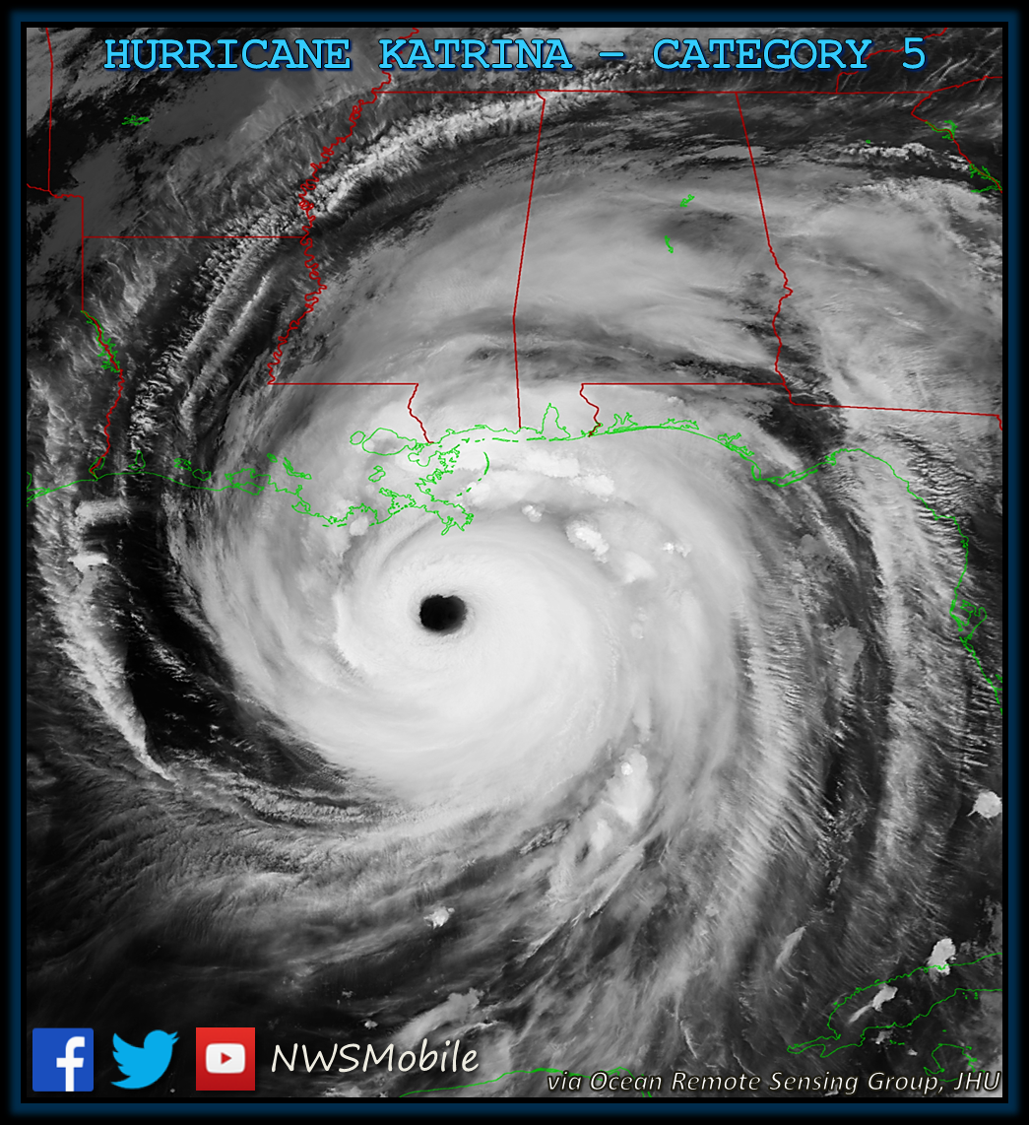
Katrina: August 29, 2005
At 6:10 AM, Katrina made its third landfall as a strong Category 3 hurricane at Bay St. Louis, MS, with sustained winds of more than 125 mph (205 km/h), and gusts over 140 mph.

Slide 5
Setting the Stage
Internal Operations the Day After
Employee Contact
PAYDAY-NO ELECTRICITY
Deploy Staff
External Work Immediately After
Devastating Losses, Public and Private (affecting government services)
PAYDAY
Contact to and from other entities, including other states
ASK for HELP
Two days to prepare
OSA has numerous divisions
Worked with Emergency Management & Government Officials
Investigators Assigned to Work with Other First Responders
Placed Audit Employees at State EOC
Made Pre-Storm Contact with All OSA Employees

Slide 6
The Storm’s Impact
Storm Surge
28-37 ft in Bay St. Louis and Waveland, MS
20+ ft. in Biloxi and Pascagoula more than 55 miles to the East
Destruction and Tornadoes across more than 80% of Mississippi
Survived Camille, Destroyed by Katrina
Buildings, Banks, Homes, Roads, Underground Infrastructure—All Destroyed on the Coast in just hours.

Slide 7
Polling Question 1: Which of these famous people are from Mississippi?
Actor James Earl Jones
Nobel Laureate Author, William Faulkner
A, E, and G
B, D, and H
All of the Above
None of the Above
NFL Great Walter Payton
MCI/WorldComm CEO Bernie Ebbers
Motivational Speaker, Zig Zigler
FEDEX Founder Fred Smith
Oprah Winfrey
Muppet Creator Jim Henson

Slide 8
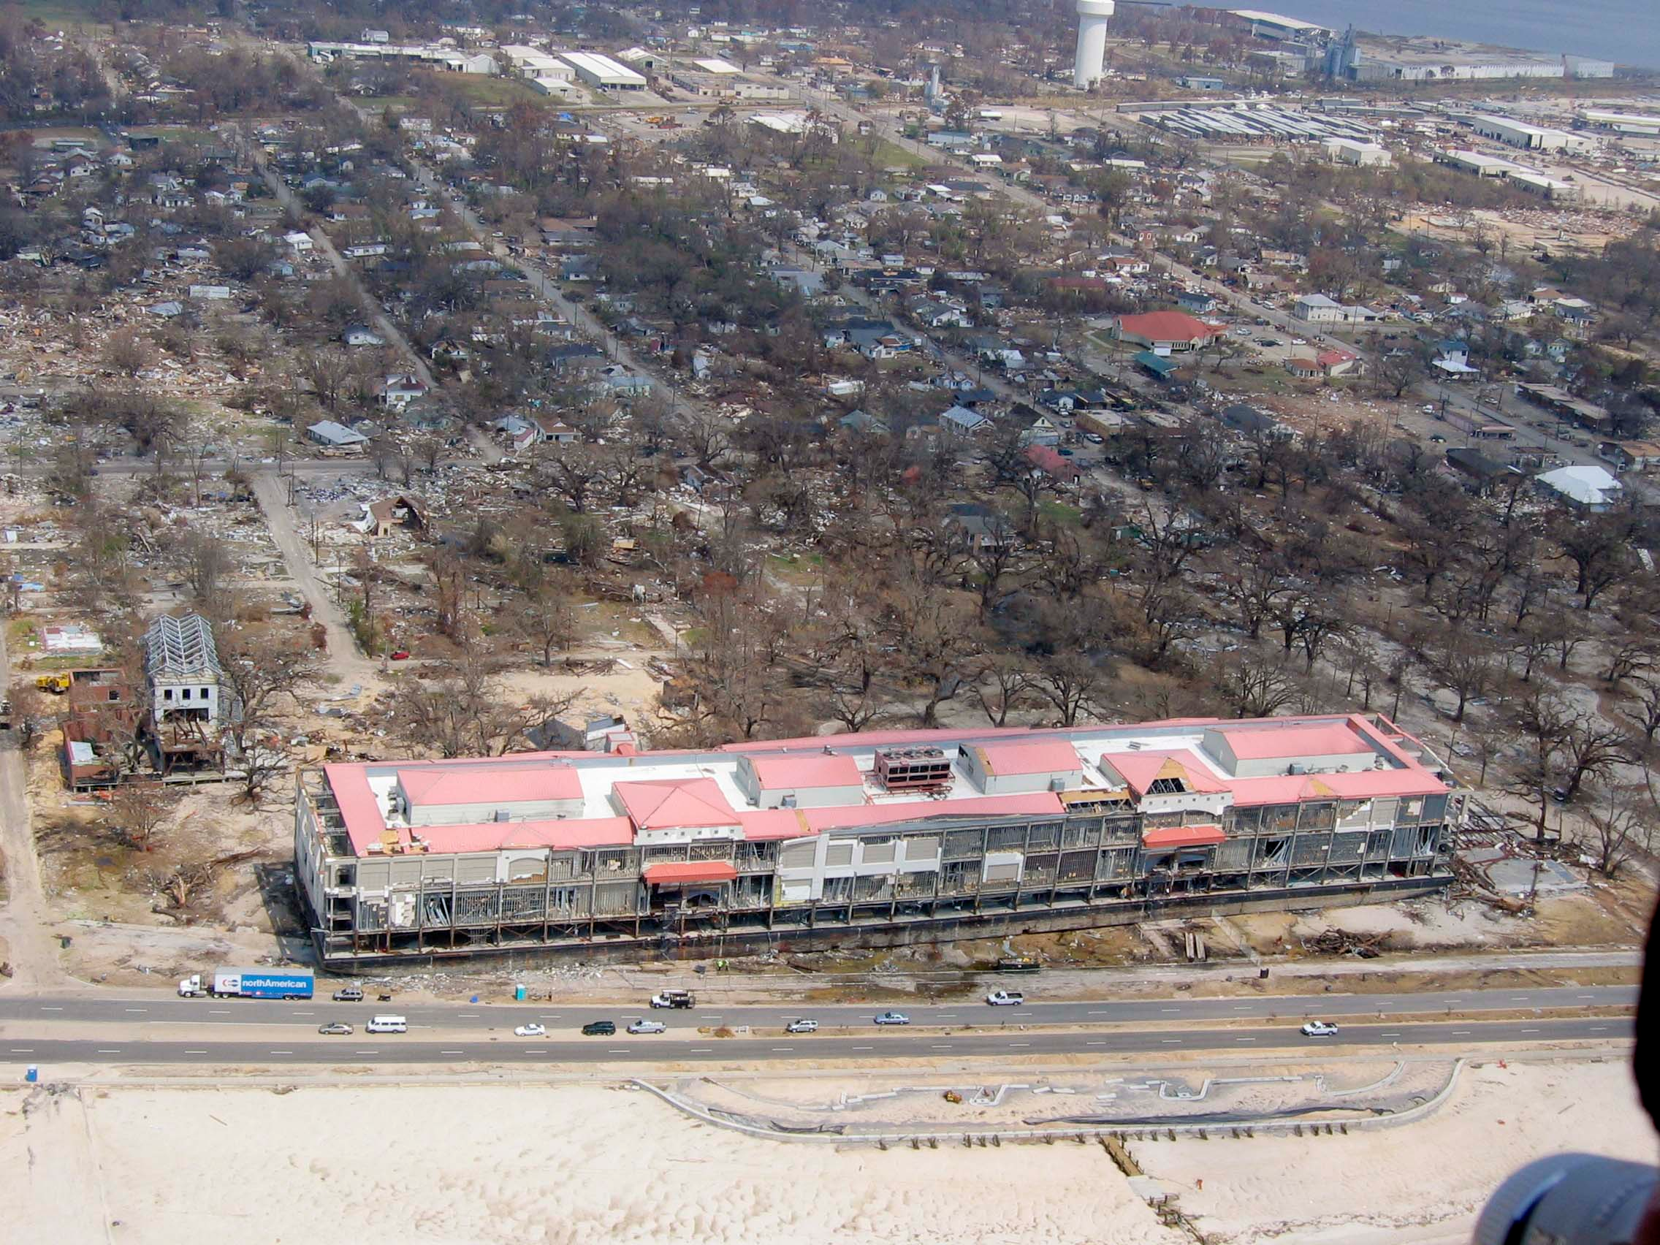
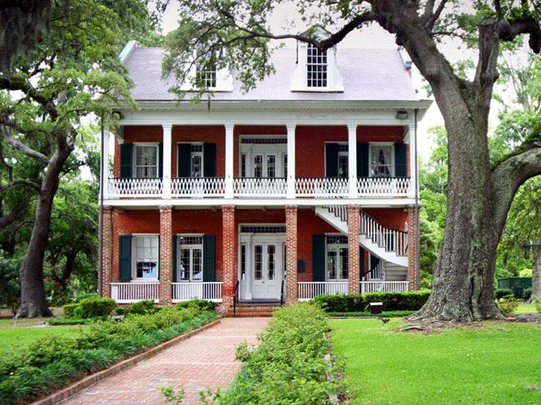
Before and After

Slide 9
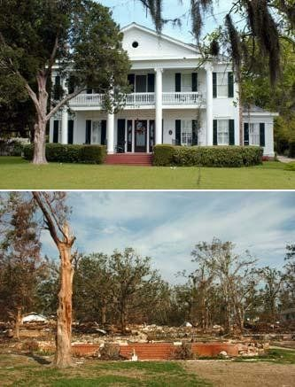
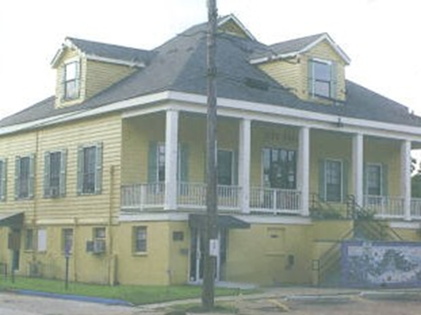
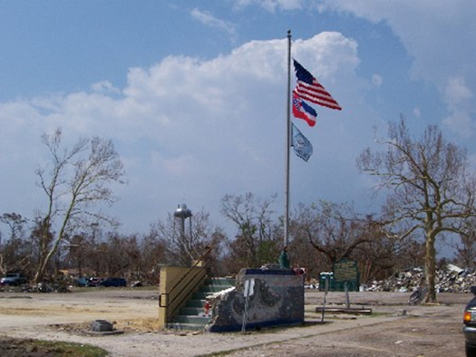
Before and After

Slide 10
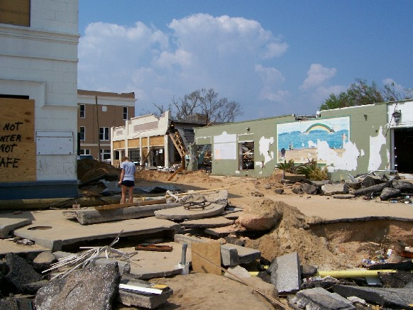
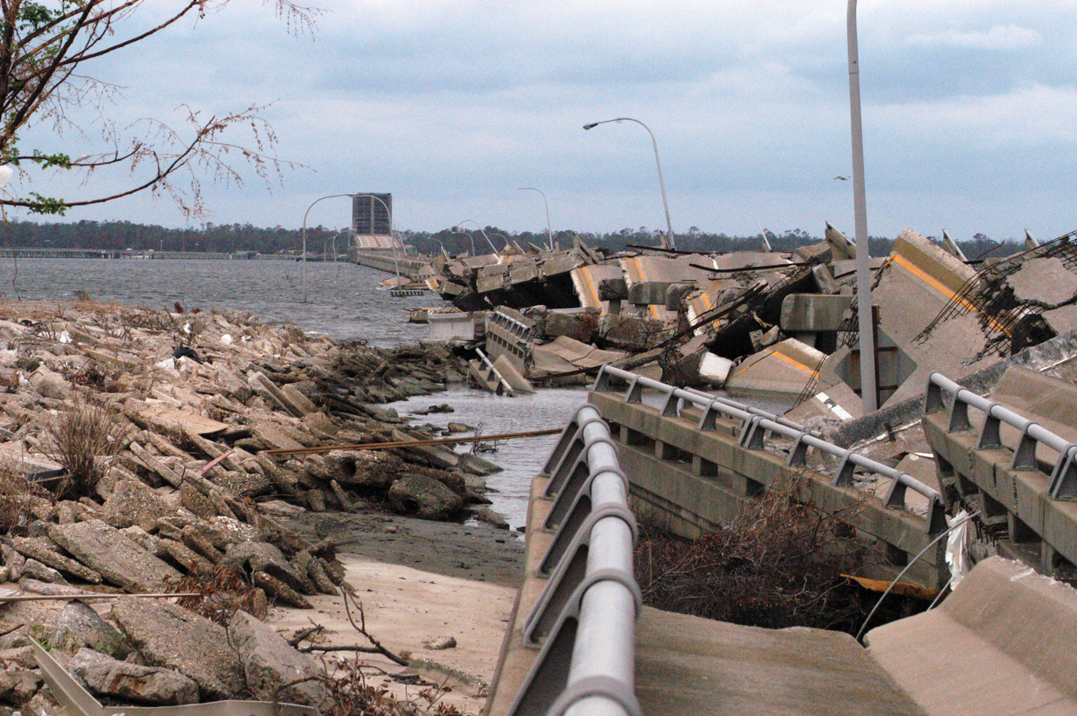
The Aftermath

Slide 11
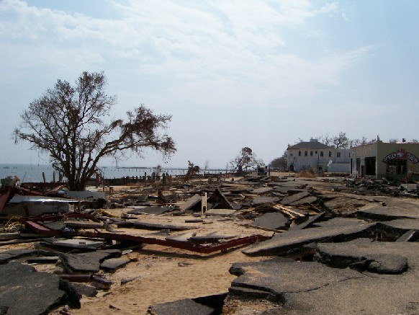
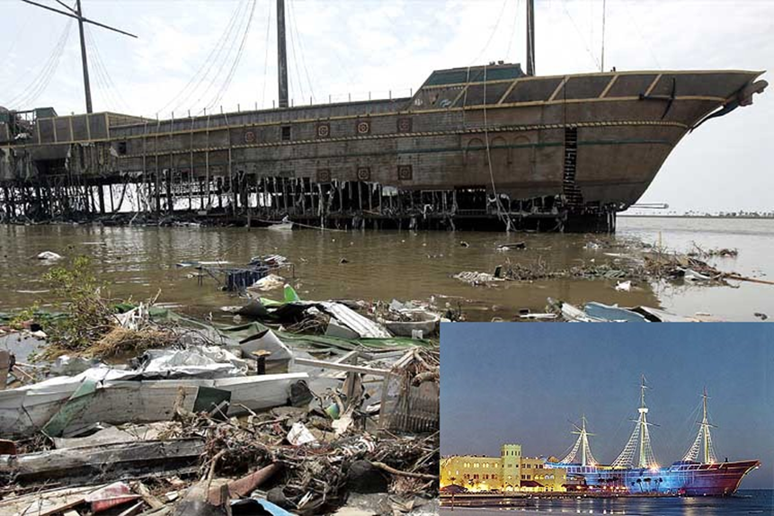
The Aftermath

Slide 12
Polling Question 2: Which of these was invented in Mississippi?
Selling Shoes in Pairs (left with right in a box)
The Teddy Bear
1st human heart and lung transplant
Pine-Sol
Rayon Fiber
Gamma Electric Cell
B and D
A and C
All of the Above
None of the Above

Slide 13
Katrina: The Aftermath
Investigators & Financial Auditors
Technical Assistance & Performance Audit
Work with Federal Officials
Review Purchasing/Contracting Laws
Provide Information & Assistance

Slide 14
Tracked, Audited, & Reported Recovery Funds
Ongoing Training—State and Local
Monitored and Audited Oversight of Contracts
OSA Property Division

Slide 15
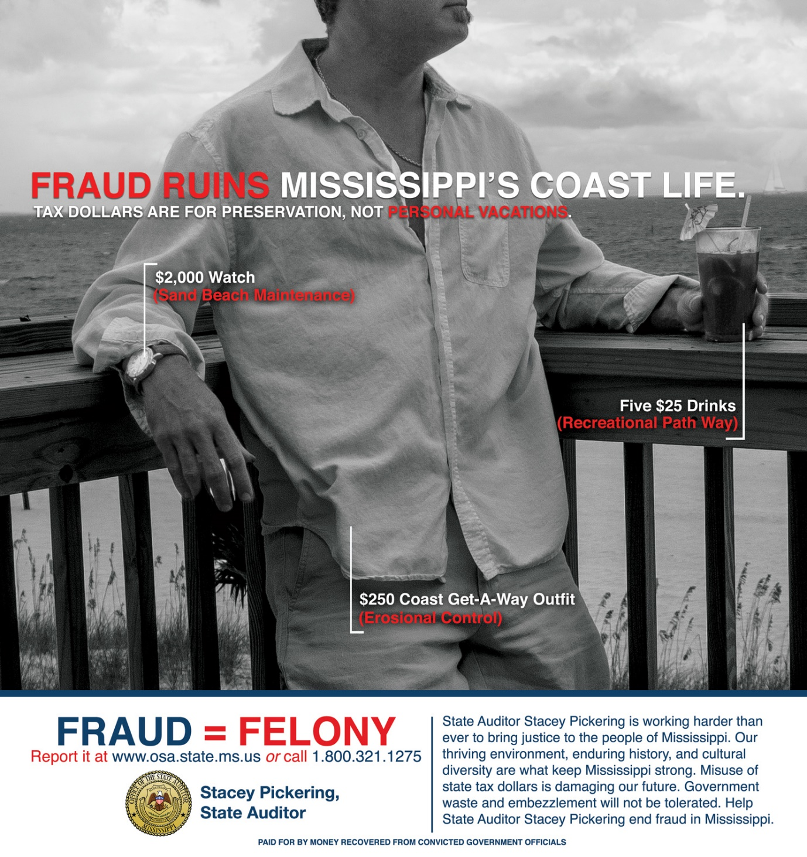
Long-Term Fraud Prevention
Let the public know you are watching

Slide 16
Katrina: From 2005 to 2012
Federal Government Demands Repayment
$1.8 billion/7,500 claims sampled
More than $250 million determined to have been misspent
Multi Agency Team
OSA work resulted in reduction to below $200,000

Slide 17
Polling Question 3: Which of these companies started in Mississippi?
Stetson Hats
Peavey Electronics (Music)
Viking Range Corporation
Flexible Flyer Snow Sled
Mossy Oak Outdoors
Bryan Foods
Pirouline Wafer cookie rolls
A, E and G
B, C, and F
All of the Above
None of the Above

Slide 18
Prevention is the Best Medicine
Prepare for they types of disasters that may occur in your geographical region
Have plans for
Loss of power and internet
Loss of local documentation—use offsite storage and redundant backups
Temporary loss of personnel—personal disasters
Disaster operations-before, during, and after
Oversight agencies can take an active role in training and preparation
Providing useful information
Conducting “Real Time” Audits
Identifying weaknesses in internal control, contracting, etc.
Watching and reviewing after the disaster
Consider having a generic template for emergency declarations with contingent authority to act

