Slide 2
Lessons Learned:
Responding to and Accounting for Natural Disaster
Katrina and Beyond

Slide 3
Setting the Stage
Two days to prepare
OSA has numerous divisions
Worked with Emergency Management & Government Officials
Investigators Assigned to Work with Other First Responders
Placed Audit Employees at State EOC
Made Pre-Storm Contact with All OSA Employees
Internal Operations the Day After
Employee Contact
PAYDAY-NO ELECTRICITY
Deploy Staff
External Work Immediately After
Devastating Losses, Public and Private (affecting government services)
PAYDAY
Contact to and from other entities, including other states
ASK for HELP

Slide 4
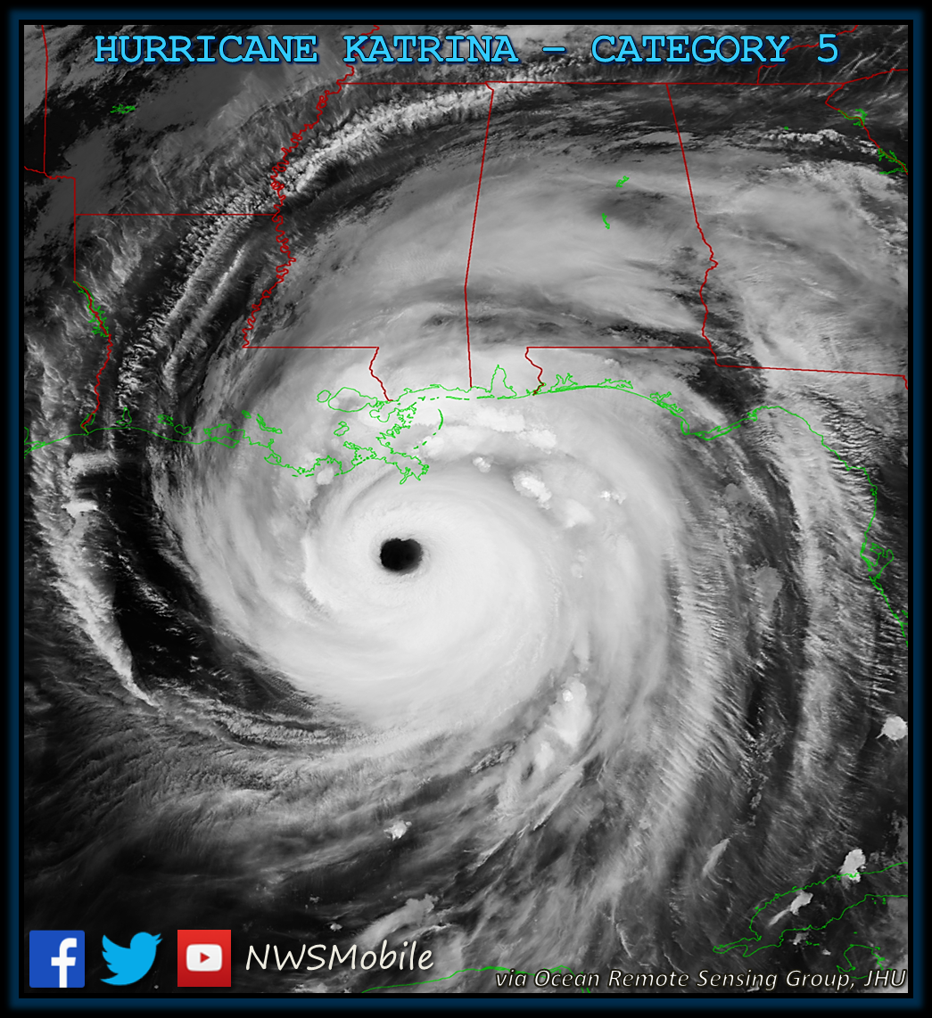
Katrina: August 29, 2005
At 6:10 AM,
Katrina made its third landfall
as a strong Category 3 hurricane at Bay St. Louis, MS,
with sustained winds of more than 125 mph (205 km/h), and gusts over 140 mph.

Slide 5
The Storm’s Impact
Storm Surge
28-37 ft. in Bay St. Louis and Waveland, MS
20+ ft. in Biloxi and Pascagoula more than 55 miles to the East
Destruction and Tornadoes across more than 80% of Mississippi
Survived Camille, Destroyed by Katrina
Buildings, Banks, Homes, Roads, Underground Infrastructure—All Destroyed on the Coast in just hours.

Slide 6
Prepare Before the Disaster Begins
More money than your organization has ever handled before
New rules may affect prior programs and reporting
Expect new responsibilities, limitations, and expectations to be attached to recovery money
Rules will change along the way—implement a process to document everything

Slide 7
Prepare Before the Disaster Begins
Ensure people handling money and overseeing programs know their requirements
Conduct necessary training regularly
Have policies in place that are easily understandable and enforceable
Work with other, external regulators and oversight agencies if they offer disaster planning

Slide 8
Recovery Starts Before the Disaster Begins
Have written, enforceable grant/contract management policies and procedures
Team approach to grant/contract administration
Award acceptance procedures
Reliable and accurate updates and information for the Governing body
Central administration recordkeeping
General Recordkeeping procedures
Reporting procedures
Payroll documentation
Travel documentation
Training expenditure procedures and documentation
Purchasing, receiving, & payment recordkeeping
Vender and subcontractor minimum requirements
Inventory control systems and documentation for grant files
Grant close-out procedures
Ensure governing body knows the rules

Slide 9
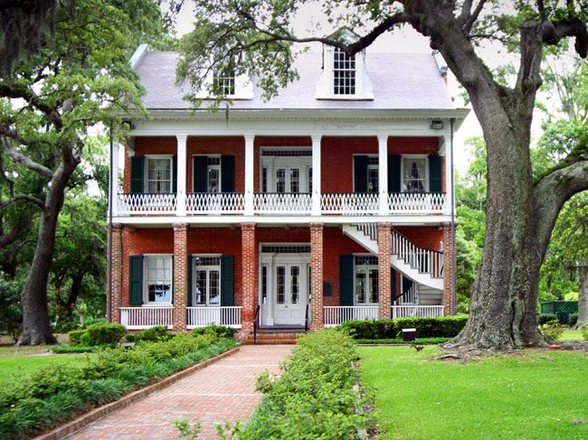
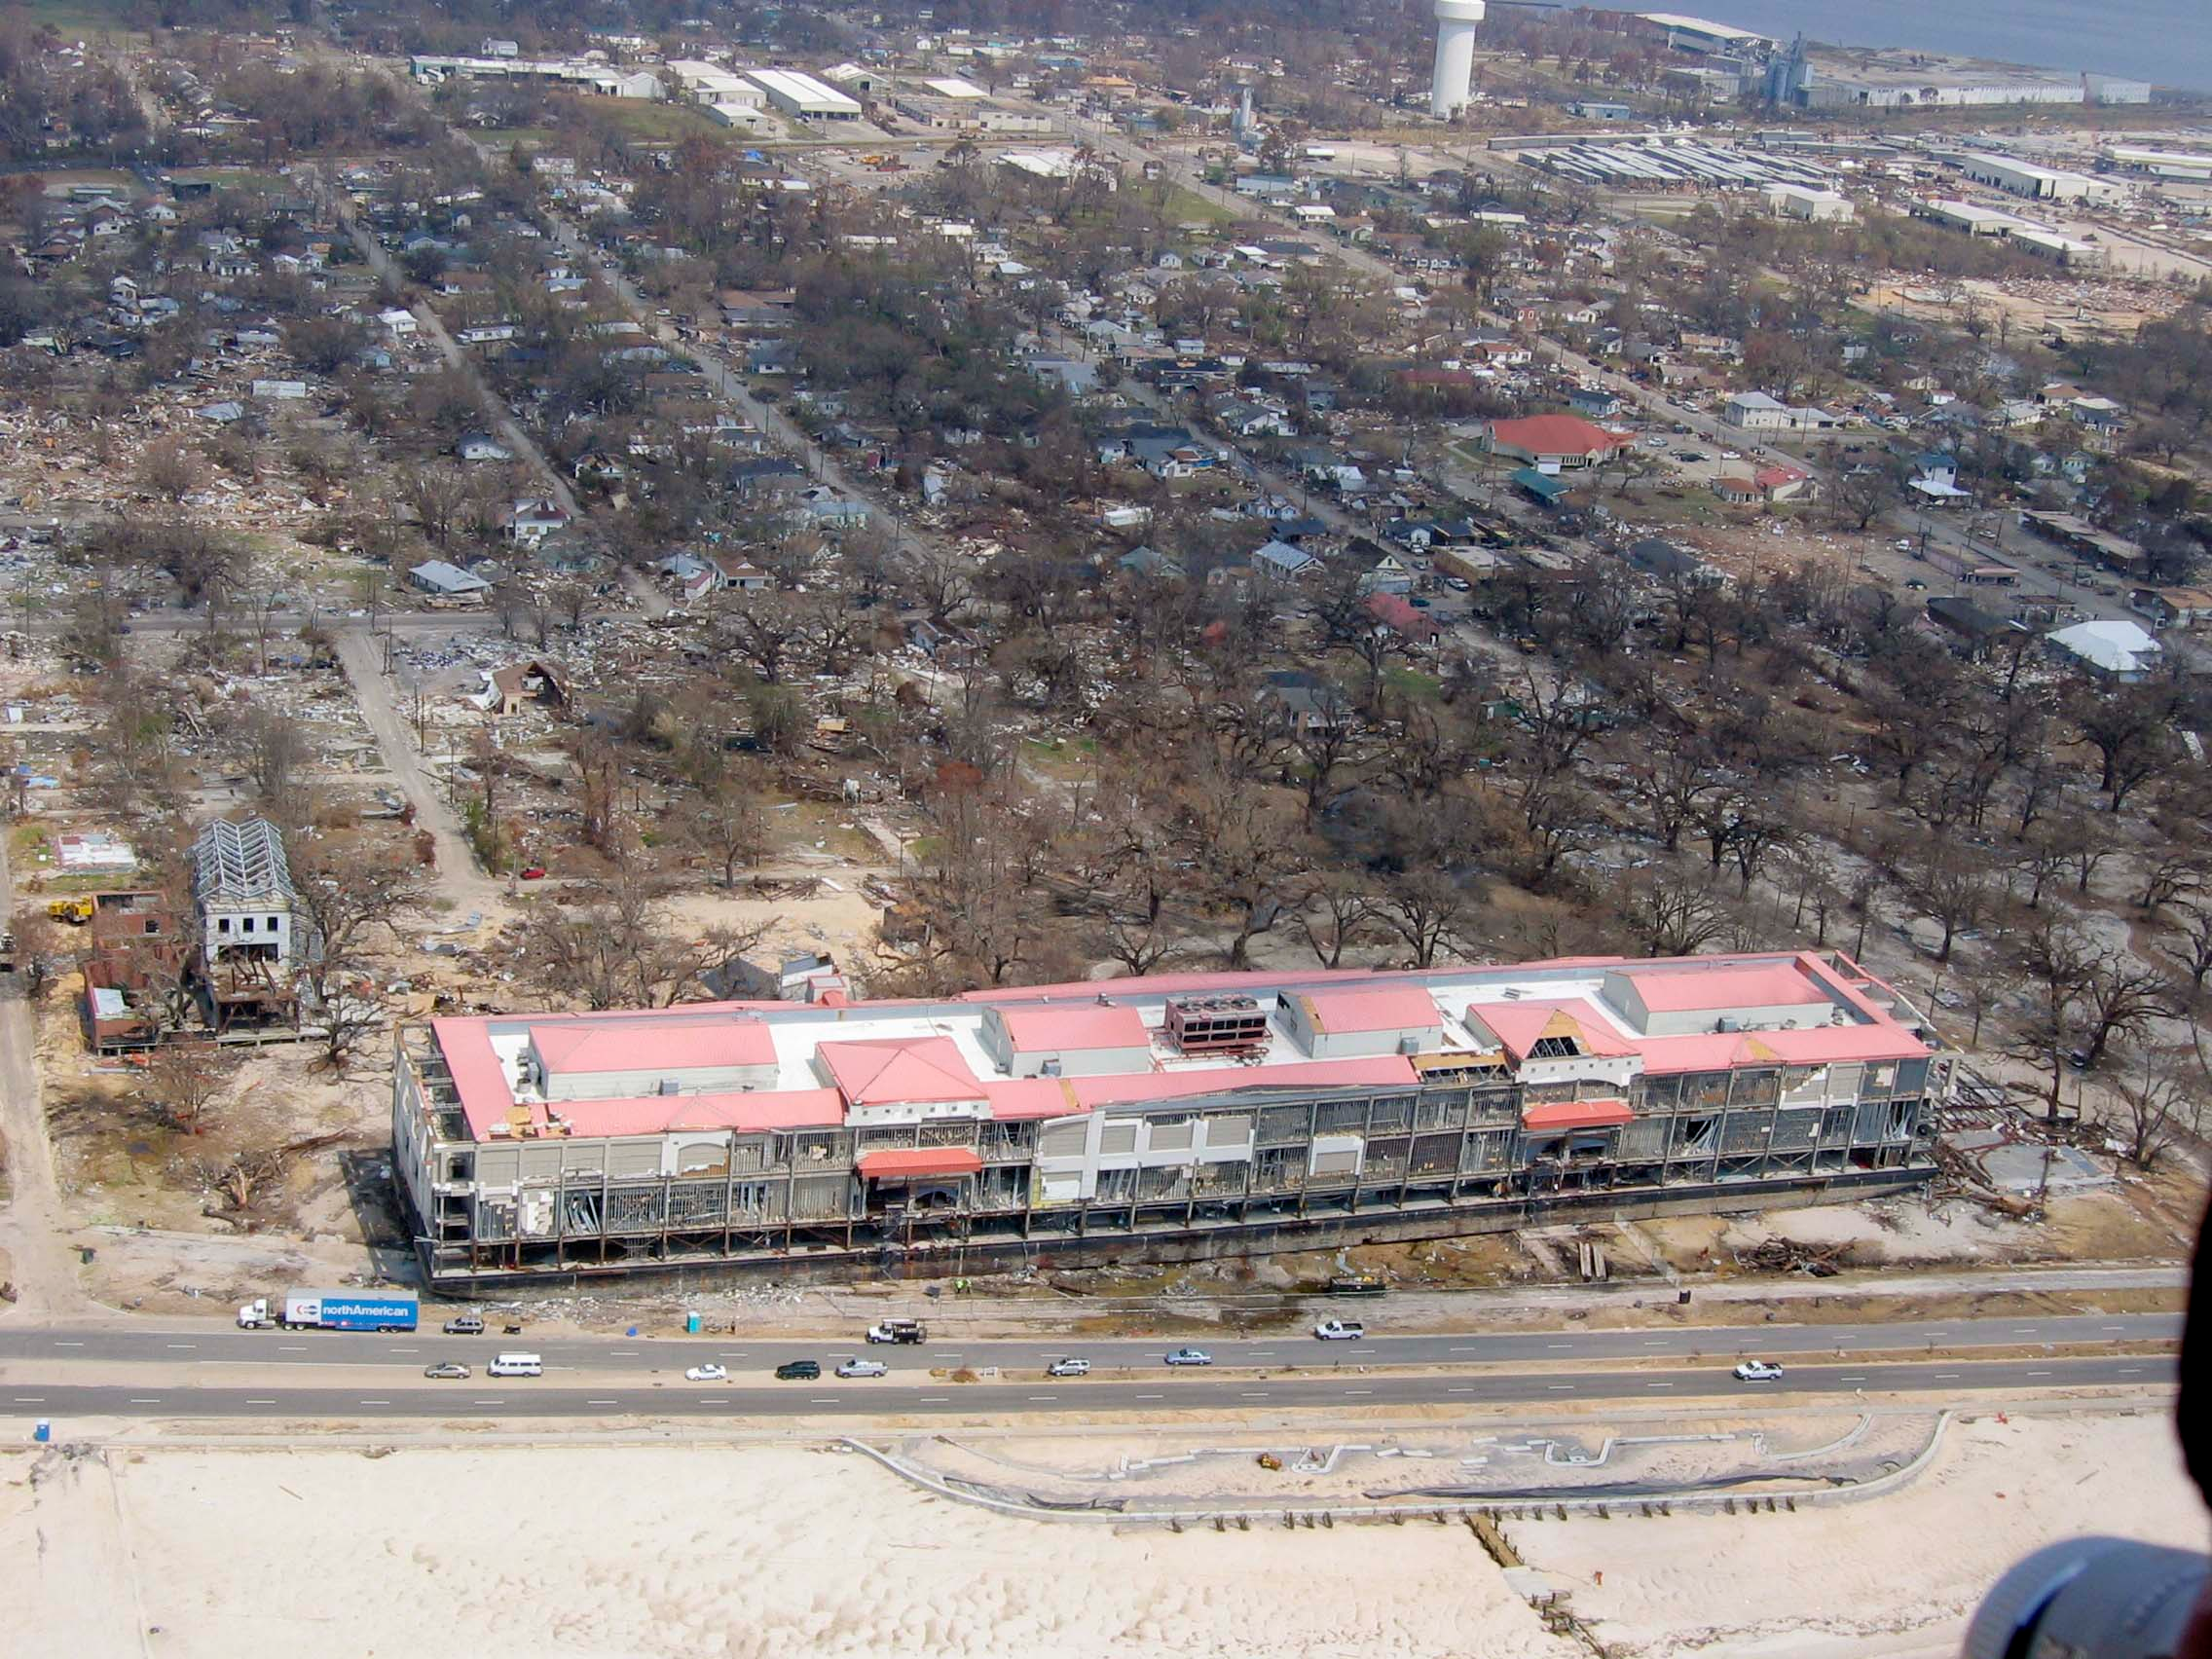
Before and After Katrina

Slide 10
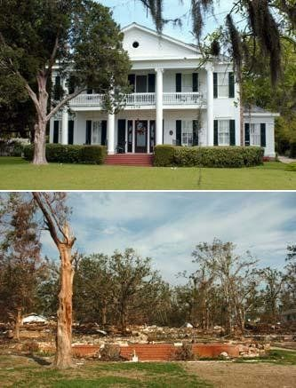
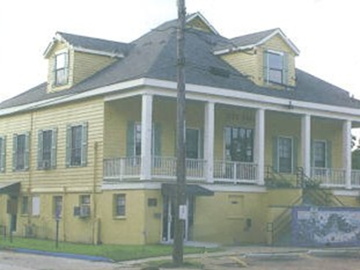
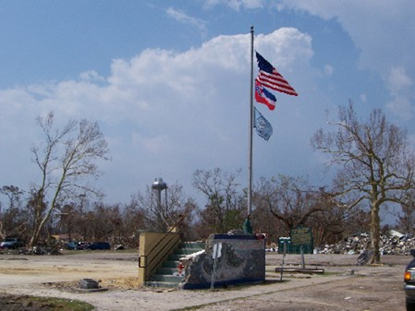
Before and After Katrina

Slide 11
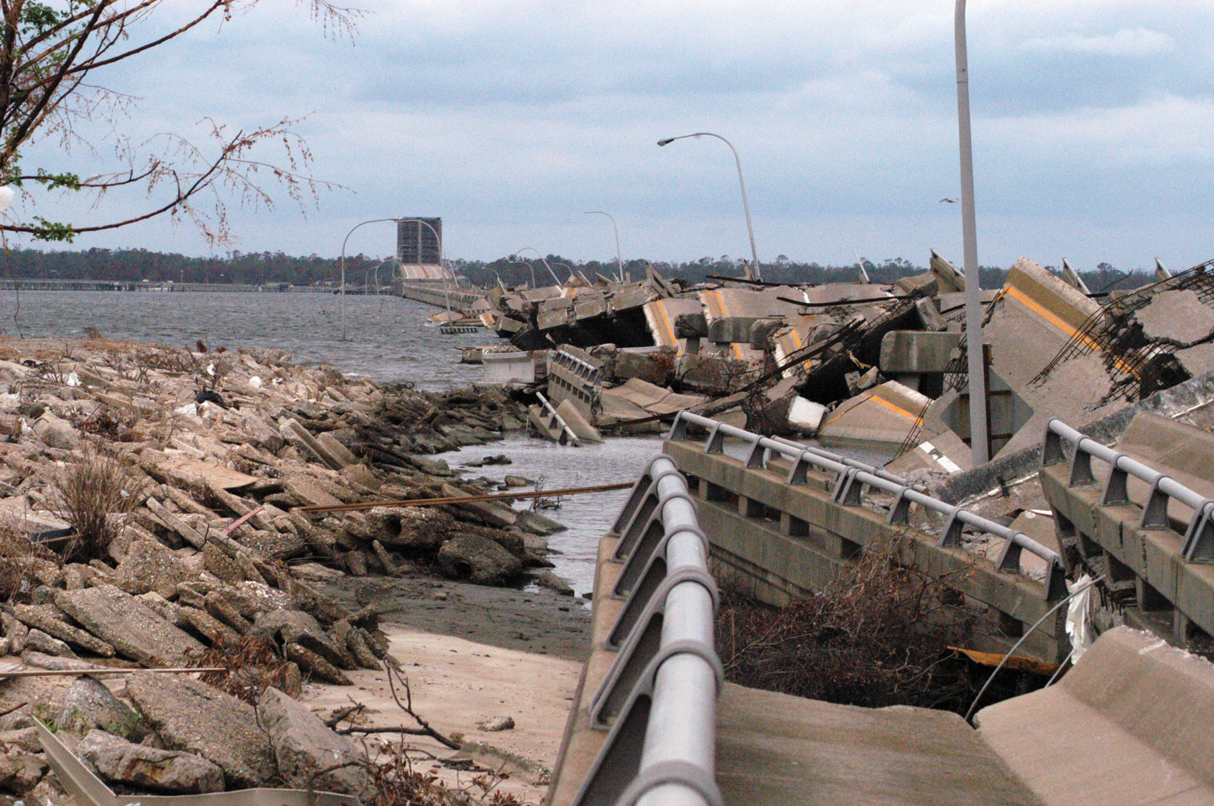
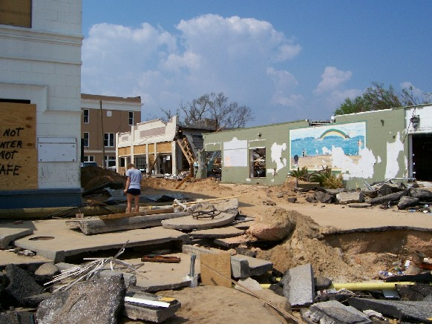
Before and After Katrina

Slide 12
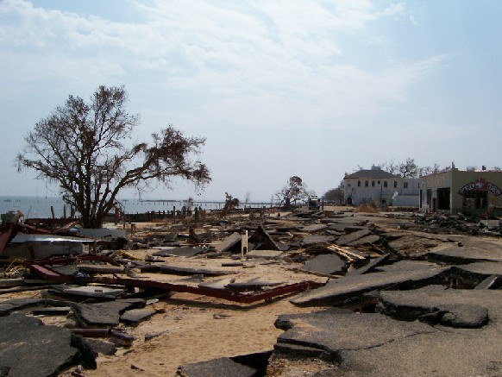
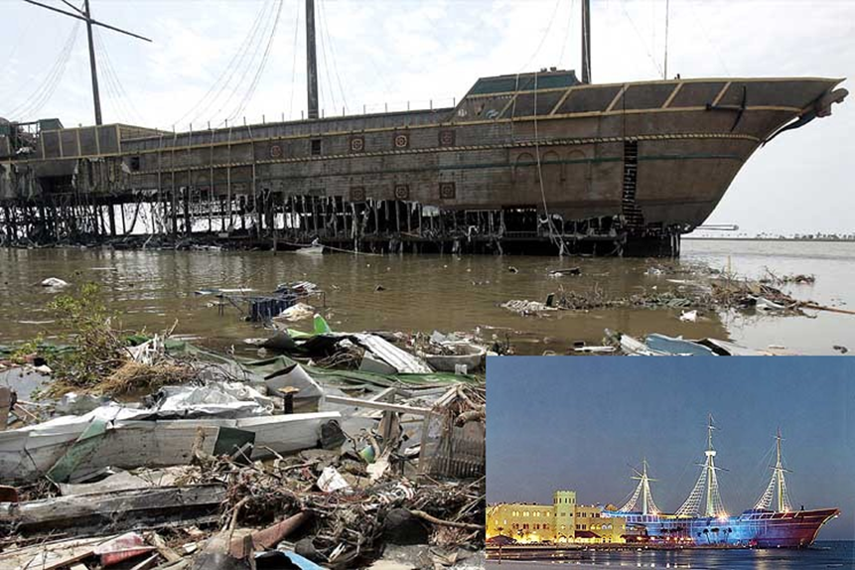
Before and After Katrina

Slide 13
Act After the Disaster
Monitor activities, systems more closely
Document more than usual (especially communication with grantors)
Take the time to screen applicants-no rubberstamps
Approach contracts even more seriously than usual
Review work performed internally and externally
Be aware of common post disaster scams

Slide 14
OSA After Katrina
Tracked, Audited, & Reported Recovery Funds
Ongoing Training—State and Local
Monitored and Audited Oversight of Contracts at local level
OSA Property Division was invaluable
Investigated complaints
Worked with Federal officials
Let the public know we were watching
Long-term fraud prevention activities

Slide 15
Prevention is the Best Medicine
Prepare for the types of disasters that may occur in your geographical region
Have plans for
Loss of power, cell phones, and internet
Loss of local documentation—use offsite storage and redundant backups
Temporary loss of personnel—personal disasters
Disaster operations—before, during, and after
Oversight agencies can take an active role in training and preparation
Providing useful information
Conducting “Real Time” Audits
Identifying weaknesses in internal control, contracting, etc. (& fix them)
Watching and reviewing activities and documentation after the disaster
Consider having a generic template for emergency declarations with contingent authority to act

Slide 16
Importance of Internal Controls
Internal controls are an ongoing process; people and not just policies; reasonable, and able to be implemented
Examples of Internal Controls:
Separation of duties
Authorization and approval, reconciliation and review
Verification (people, activities, documents)
Physical control and security of assets
Training, guidance, and monitoring (P&P)
Lack of segregated duties often leads to fraud
Even in small offices there are ways to separate duties

Slide 17
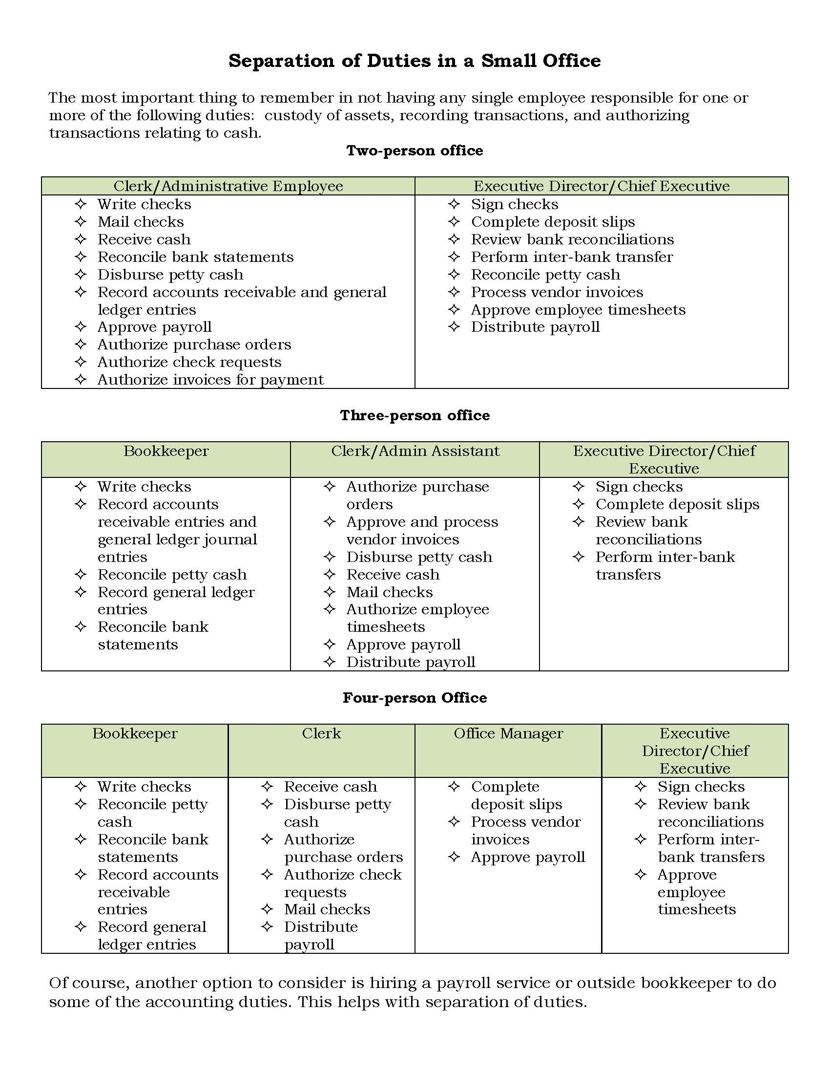
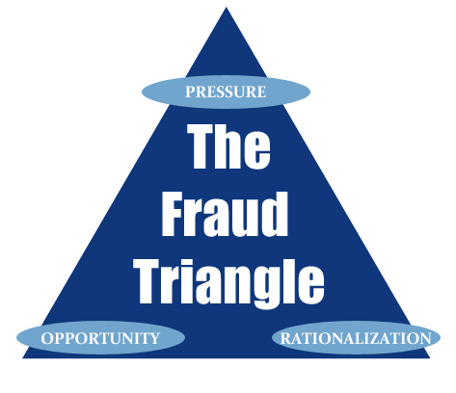
Small Offices

Slide 18
What is Occupational Fraud & How Can It Happen?
Using your job for personal gain through the deliberate misuse of your employer's resources or assets
How is it Categorized?
Asset Misappropriation
Corruption
Financial Statement Fraud
Failure to look for, or ignoring, unusual trends, discrepancies, or transactions
Failure to understand complex systems
Failure to reconcile information between sources
TRUST without verification
False belief that everything is fine
Rushing without care—too much emphasis on timelines

Slide 19
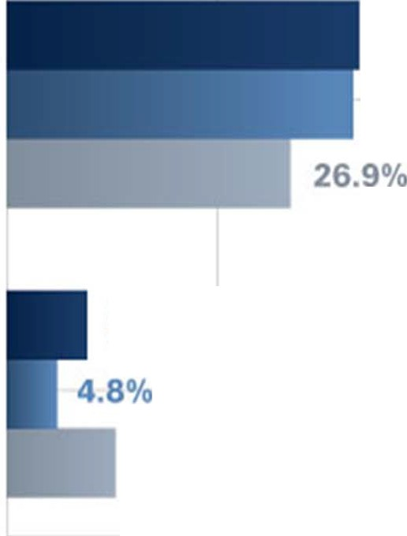
2012
86.7%
Asset
Misappropriation
88.7%
2010
33.4%
2008
Corruption
32.8%
Financial
Statement Fraud
7.6%
10.3%

Slide 20
A Typical Fraudster?
Least Suspected
Tenured
Trusted
Educated
Fraudsters do not look like crooks!

Slide 21
Create an Anti-Fraud Environment
Set the tone at the top = Lead by Example
Responsibility of elected officials and City management
Behave ethically and openly communicate expectations to employees
Treat all employees equally
Zero tolerance
Create a positive workplace environment
Focus on employee morale
Empower employees
Communicate
Have a Fraud Policy that is applied to all (elected, appointed, hired, executive, staff, vendors, contractors, consultants)
Hire and promote appropriate employees
Conduct background investigations before hiring or promoting
Check candidate’s education, employment history, references
Continuous and objective evaluation of compliance with entity values
Violations addressed immediately
Code of Conduct
Formalized and founded on integrity
Defines acceptable employee behavior
Communicated to all employees
All employees are held accountable for compliance

Slide 22
Create an Anti-Fraud Environment
Discipline
Sends a strong message throughout the entity
Should be appropriate and consistent
Consequences of committing fraud clearly communicated throughout the entity
Oversight Process
Public Employees/Officials
Evaluate management’s “tone at the top”, identification of fraud risks, and implementation of anti-fraud controls
Ensure that management implements anti-fraud measures
Consider the potential for management override of controls
Management
Directs, implements and monitors anti-fraud controls
Sets the ethical tone
Trains employees –Training is important
Internal Auditor (if available)
Identifies fraud indicators
Assesses fraud risks
Evaluates anti-fraud controls
Recommends actions to mitigate risks
Investigates potential frauds

Slide 23
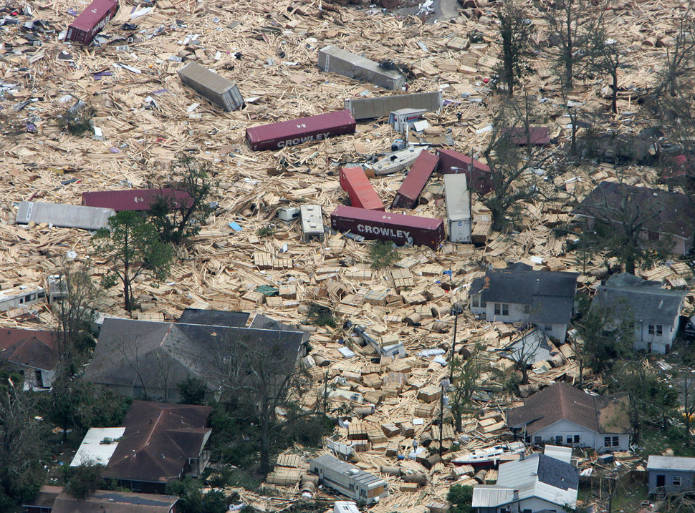
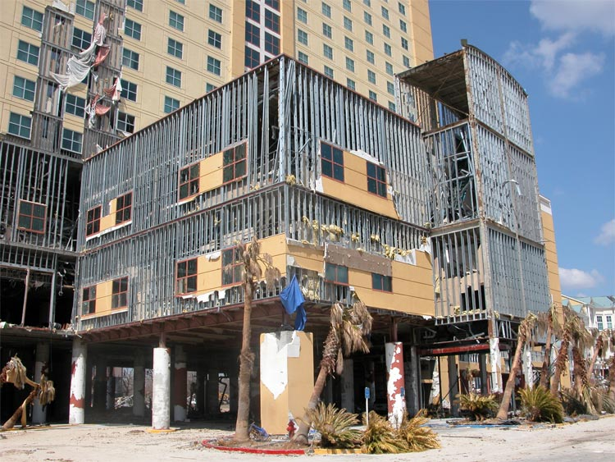
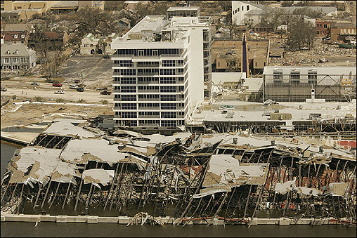
The Aftermath of Katrina

Slide 24
Evaluate Your Internal Controls
Periodic review of policies and procedures
Clear and specific training and feedback
Adequate oversight of:
Payments
Cash
Contracts
Accounting
Conflicts of Interest
ETHICS!
Disclosing Conflicts of Interest
Use of Public Property
Misuse of Position
Public Endorsements
Gifts from vendors and lobbyists

Slide 25
Make Your Controls Work To Prevent Fraud
Everyone within an organization has responsibility
Preventing fraud starts with solid internal controls
Control Activities
Policies & Procedures
Employees who understand the organization and their role
KNOW the signs, Implement Controls, Protect Yourself, Your Organization, and Your Constituents

Slide 26
Prevention Top 10
Partner with employees to create an anti‐fraud culture.
Implement an anti‐fraud program and increase the perception of being caught.
Become involved in the financials with a focus on “anomalies.”
Be careful with checks, which are essentially cash.
Establish policies for credit purchases.
Pay attention to signs of a fraud.
Assess anti‐fraud controls and improve them.
Understand the profile of a fraudster.
Implement an effective anonymous tips and complaints system.
Request a fraud assessment.

Slide 27
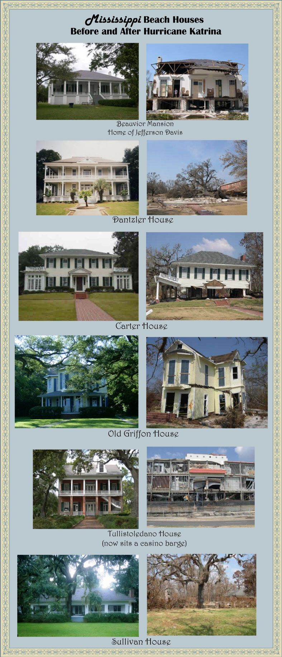
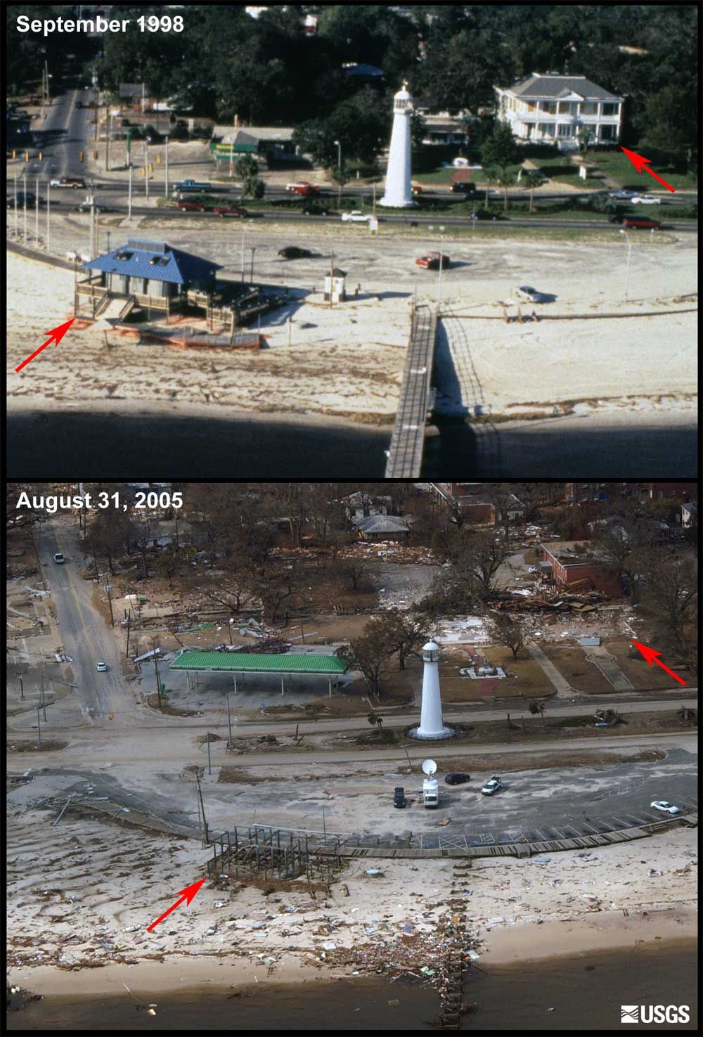
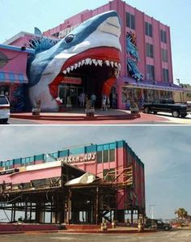
Before and After Katrina

Slide 28
Questions?
Samantha Atkinson
Director of Special Projects and Audit Response Teams
Mississippi Office of the State Auditor
PO Box 956
Jackson, MS 39205
Office: 601.576.2655
Toll Free: 800.321.1275
www.osa.ms.gov
Sam.Atkinson@OSA.MS.Gov

